Slide 2
LESSON 9
Wounded
for You
Isaiah 52:13-
53:12
1 Peter 2:21-25

Slide 4
OVERVIEW
Garden Coverings
Abraham & Isaac
The Passover
OT Sacrificial Offerings
Water from the Rock
Bronze Serpent
Sign of Jonah
Suffering Servant
Lamb of God
Bread of Life
Perfect Sacrifice
Washed Robes

Slide 5
LESSON SUMMARY
Hundreds of years before Christ was born, Isaiah prophesied about a mysterious Servant who would be rejected and despised, yet bring salvation through His suffering.
The early Christians believed this prophecy was made about Jesus and His life and work.
As those who benefit from the service and suffering of Jesus, we now embrace a life of suffering and service on behalf of others.

Slide 6
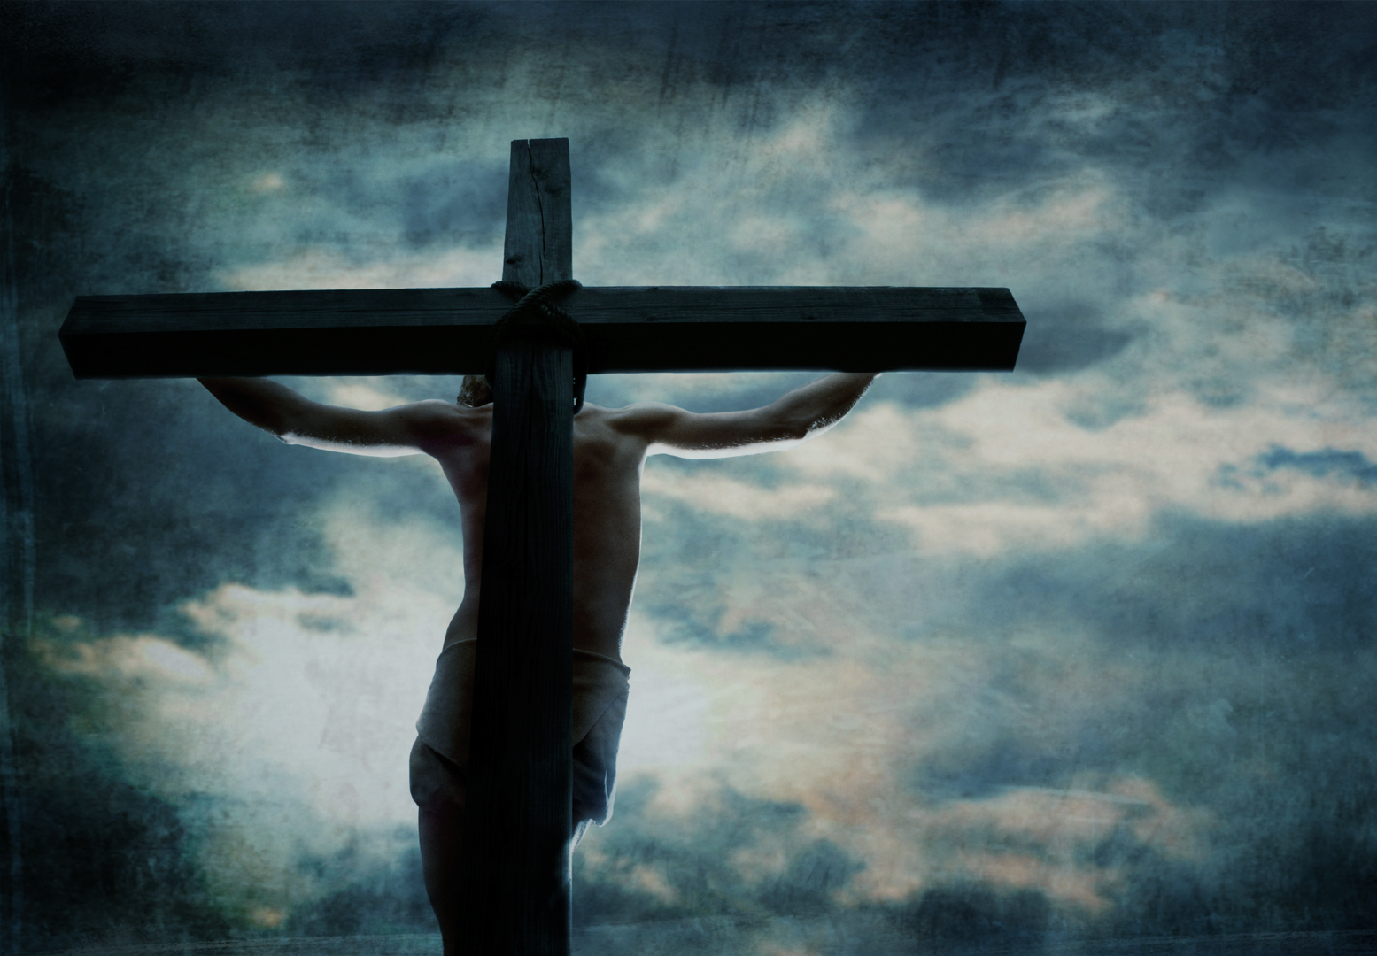
INTRODUCTION
Throughout the OT, God saw fit to give more and more insight into who the Savior would be.
No other section of the OT reveals more clearly who the promised One would be than Isaiah 53.

Slide 7
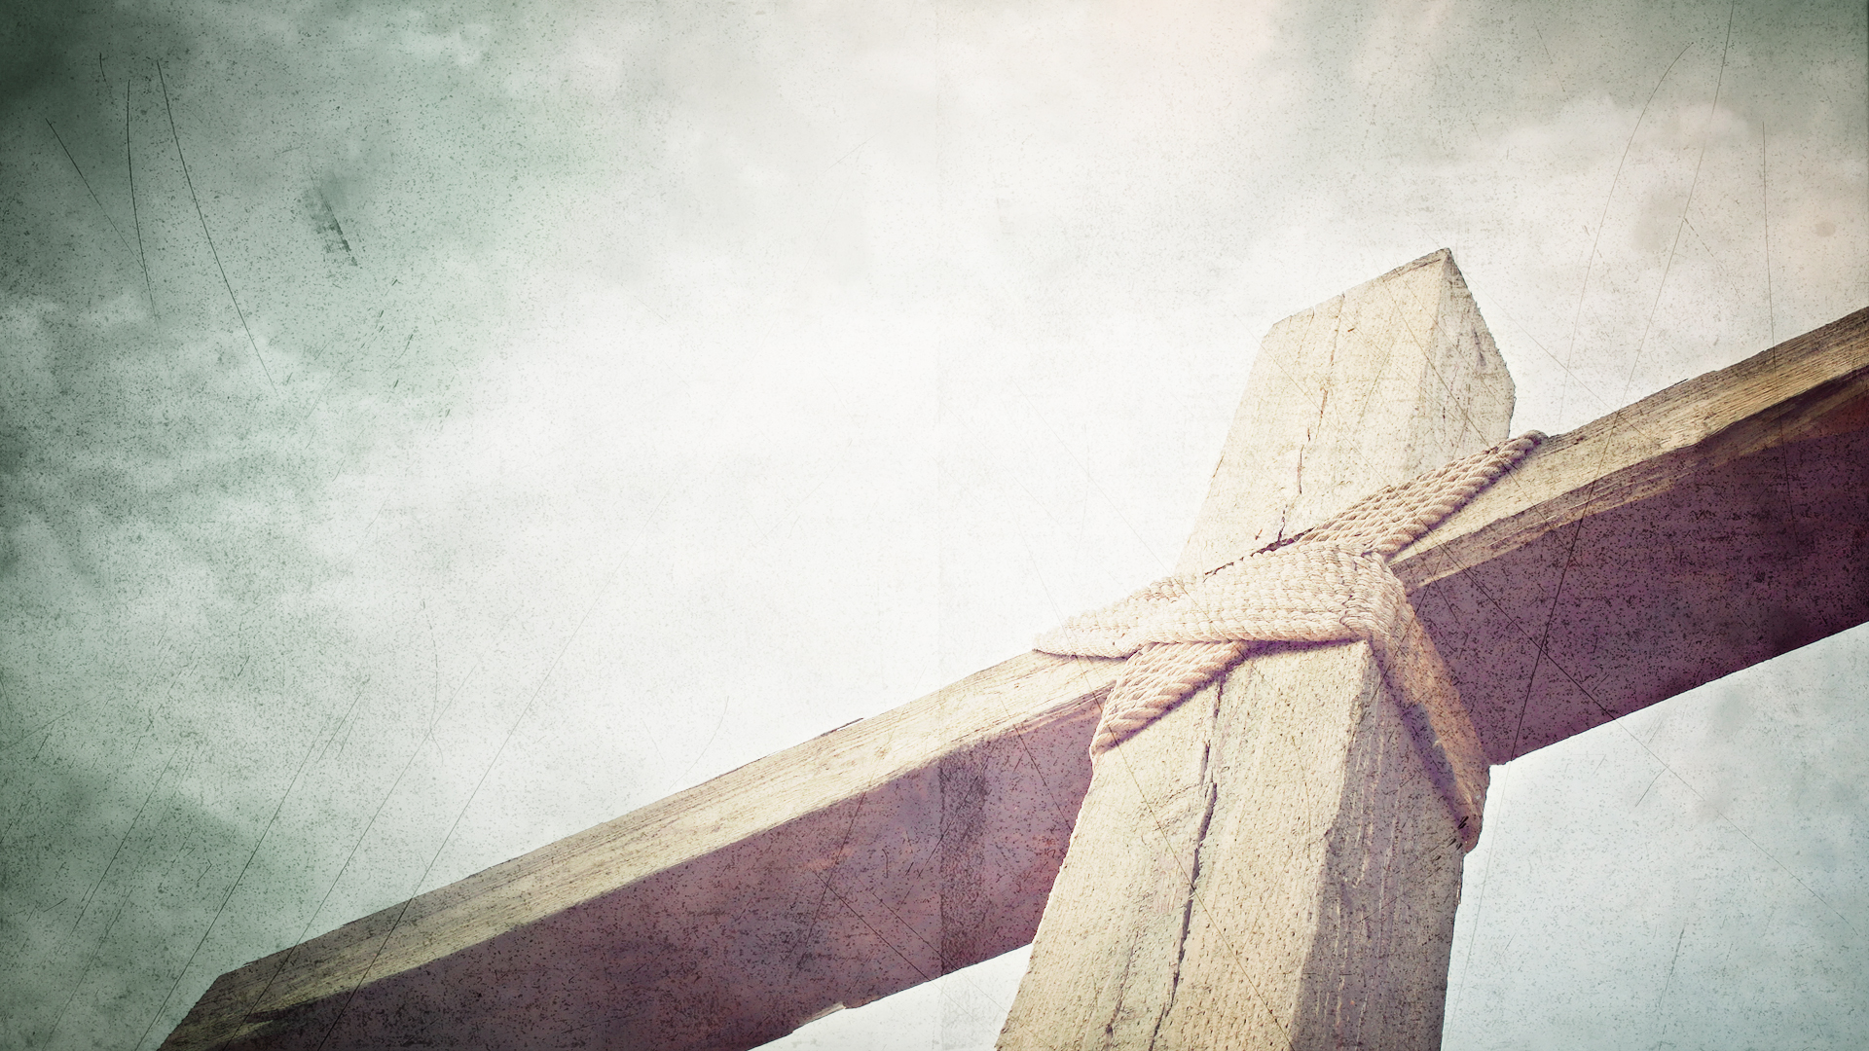
The Servant will be rejected as He suffers the consequences of our sin (Isaiah 52:13-53:9).
The Servant is doing something on their behalf, which means the Servant cannot be referring to all of Israel but to Israel represented by one person—the Messiah.
As the Messiah was dying on the cross for our sins, it appeared to the world that God was striking Him down for His own sins.

Slide 8
The Servant will be rejected as He suffers the consequences of our sin (Isaiah 52:13-53:9).
Isaiah’s portrait of the Messiah’s suffering is horrific.
The Physical Pain – the rusty nails, the splintered wood, the slow suffocation
The Emotional Pain – mocked, spat upon, rejected, ridiculed
The Spiritual Pain – bearing our sins, forsaken and abandoned by His Father

Slide 9
The Servant will be rejected as He suffers the consequences of our sin (Isaiah 52:13-53:9).
“[Jesus] was made in the form of a man who is composed of the dust of the ground. He became a servant. Finally, our Lord was sentenced to execution in a death reserved for criminals and felons. He was raised between the heaven and the earth as though both heaven and earth rejected Him.” ~ W. A. Criswell

Slide 10
The Servant accomplishes the victory of salvation through His suffering (Isaiah 53:10-12).
Why such pain? Why such suffering? Why did the Servant have to endure all of this?
It was the Father’s will (v. 10).
Jesus was an offering for guilt (v. 10).
The cross is the only way God can offer Himself fully to us as both the Just and the Merciful.

Slide 11
The Servant accomplishes the victory of salvation through His suffering (Isaiah 53:10-12).
Here we see God’s desired outcome—salvation for people—and the way it is accomplished—the death of the Servant.
The Servant suffered and died so we might live and be free.
“In Isaiah 53, God’s character expresses itself simultaneously in both forgiveness and just judgment.” ~ Paige Patterson

Slide 12
The Servant’s suffering is the basis for our service (1 Peter 2:21-25).
Join Jesus in His suffering.
Because Jesus suffered, we are to follow Him in His suffering.
The distinguishing mark of a Christian is that we rejoice in our suffering.
The Christian is not called to a life of no suffering but to a life of suffering in hope.

Slide 13
The Servant’s suffering is the basis for our service (1 Peter 2:21-25).
Die to sin and live to righteousness.
Unless we die to our sin by seeing it put upon the Servant, we will never live for righteousness by taking on His mission.
Though the debt of our sins has been paid, though sin now holds no power over us, we let guilt paralyze us.

Slide 14
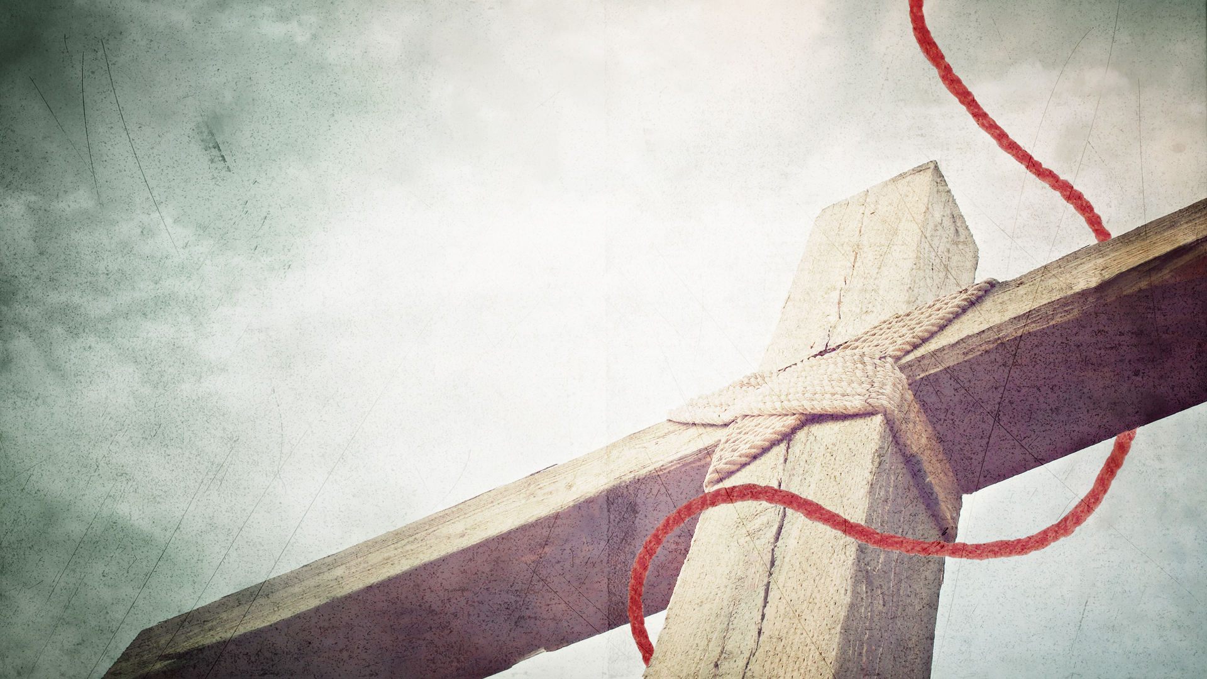
CONCLUSION
Our response is to repent of our sin and trust in Christ’s sacrifice.
Those who trust must now obey.
Because of the cross, you are free to obey with all your heart.

Slide 15
LOOKING AHEAD
LESSON 10
Behold
the Lamb!
Jn. 1:29-42

