Slide 2
LESSON 7
Look and Live!
Numbers 21; John 3:14-15; 2 Cor. 5:20-21

Slide 4
OVERVIEW
Garden Coverings
Abraham & Isaac
The Passover
OT Sacrificial Offerings
Water from the Rock
Bronze Serpent
Sign of Jonah
Suffering Servant
Lamb of God
Bread of Life
Perfect Sacrifice
Washed Robes

Slide 5
LESSON SUMMARY
When the Israelites were ungrateful and impatient, God sent poisonous snakes into their camp.
In response to their pleas for mercy, God commanded Moses to lift a bronze serpent on a staff. Whenever someone looked at the serpent, they were healed.
Jesus later claimed this story pointed forward to His being lifted high on the cross. By trusting in His identification with sinners, we are given eternal life and are called to be His ambassadors.

Slide 6
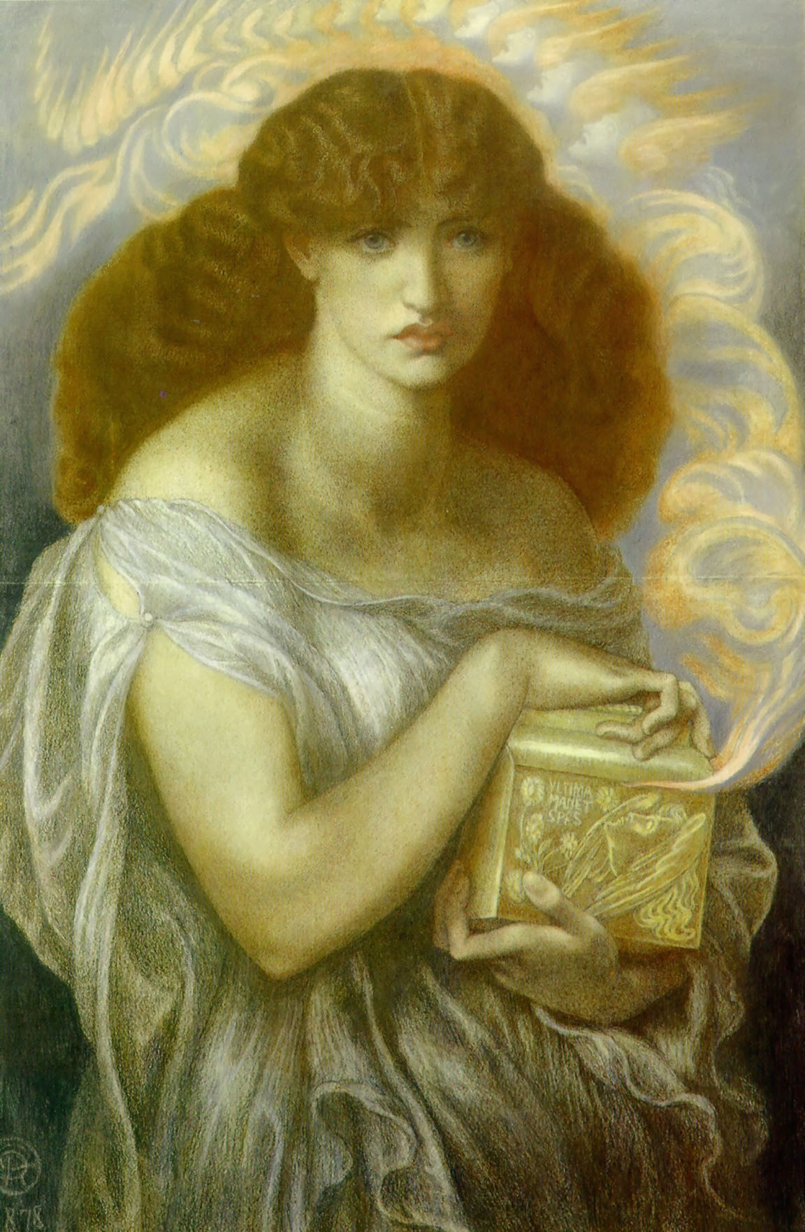
INTRODUCTION
“We know that Jesus read the Old Testament believing that it was all pointing to him. There were pointers and types and foreshadowings everywhere. But we might expect him to skip this one. It is shocking to compare the Son of Man to a snake. But Jesus doesn’t skip this one. He goes out of his way to choose it to help Nicodemus.” ~John Piper

Slide 7
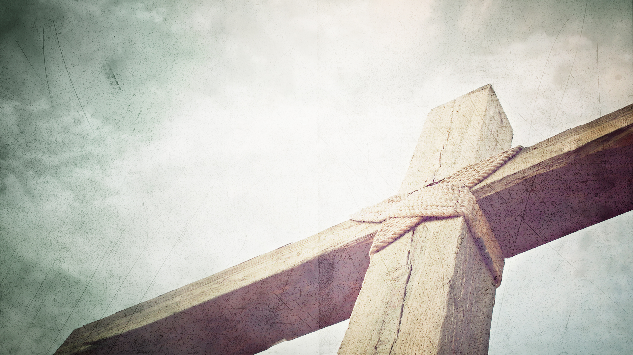
Israel is rescued by gazing upon the symbol of punishment for their sin (Numbers 21:4-9).
Again God used Moses as the instrument through which salvation came.
Israel’s emotional outburst exposed their ungrateful heart. They were despising God’s good gifts.
God punished the Israelites by sending poisonous snakes into their camp.
God instructed Moses to make a bronze snake and mount it on a pole. Those who looked upon it were cured. Those who did not perished.

Slide 8
We are rescued by gazing upon Christ, who took the punishment for our sin (John 3:14-15).
Jesus made a clear connection between this episode and what would happen to Him on the cross.
Sinners were in desperate need of rescue.
A divinely-ordained remedy was provided.
The remedy defied human logic or expectations.
Someone performed an action—a “lifting up.”
The remedy looked something like the problem.
A response was required in order for the remedy to succeed
All who respond receive the remedy.

Slide 9
Christ’s identification with sinners is the foundation for our mission (2 Cor. 5:20-21).
An ambassador was one personally appointed by the emperor to represent his interests to another party, perhaps far away.
Our Message
Jesus is the only human who lived sinlessly.
Jesus became the representative sin-bearer.
Jesus gives us His righteousness when we trust in Him.

Slide 10
Christ’s identification with sinners is the foundation for our mission (2 Cor. 5:20-21).
Our Mission
We have been sent out as ambassadors to issue the gospel proclamation and invitation.
Our mission demands extreme urgency in delivering the invitation.
As an ambassador of Christ, our invitation is simple—“Be reconciled to God.”

Slide 11
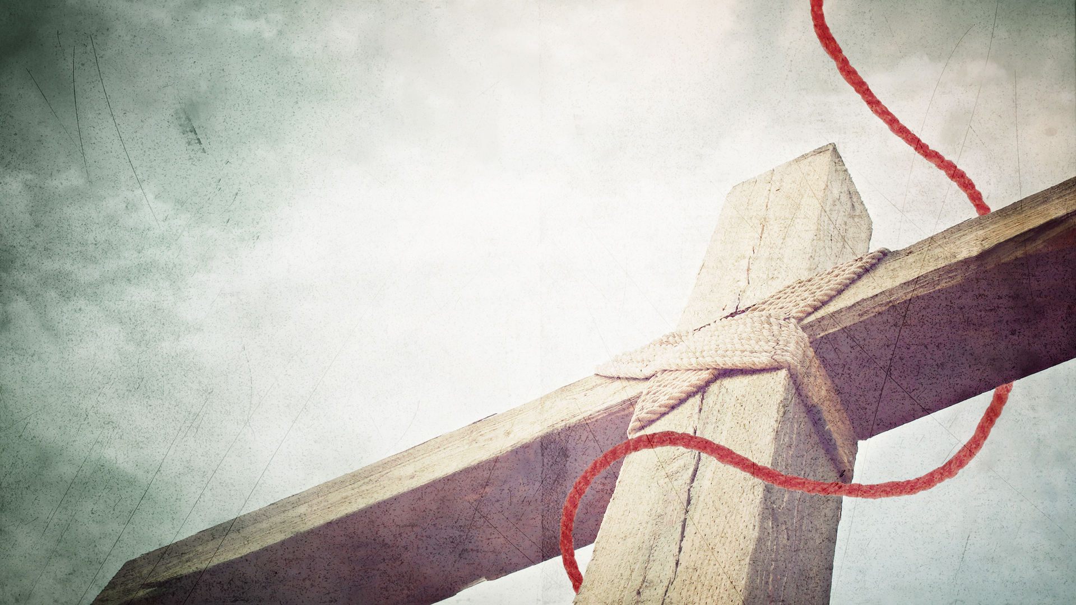
CONCLUSION
The account of the Israelites in the wilderness illustrates how God undid the serpent’s work.
When we repent and believe in the One who became sin for us, we become the righteousness of God—but only when we are “in Him” by faith.
We have been entrusted with the life-giving message of the gospel, and we urge others to be reconciled to God. “Look and live” is to be the heart-cry of every follower of Jesus to those who are perishing.

Slide 12
LOOKING AHEAD
LESSON 8
The Sign of Jonah
Jonah 1

