Slide 2
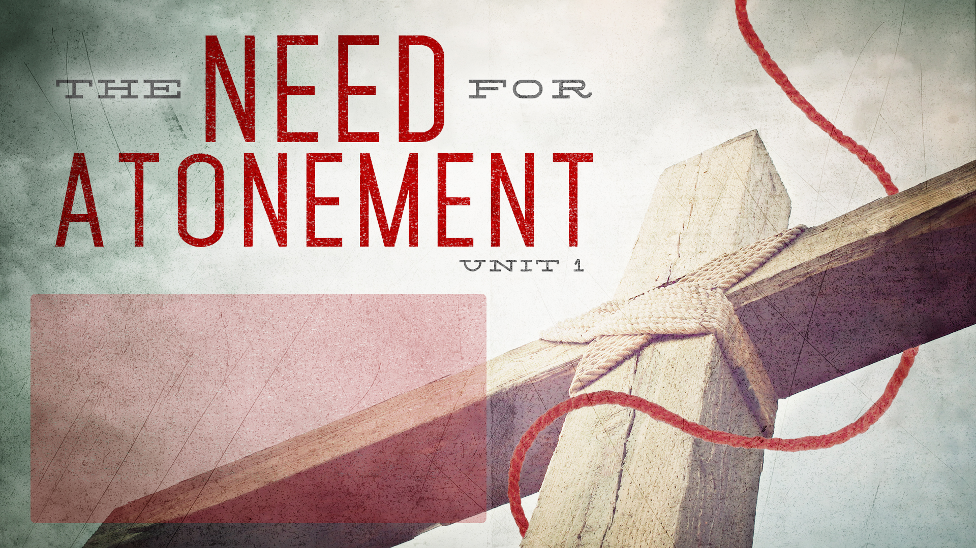
LESSON 5
Sacrifices,
Part 2
Leviticus 5;
Hebrews 9, 13

Slide 4
OVERVIEW
Garden Coverings
Abraham & Isaac
The Passover
OT Sacrificial Offerings
Water from the Rock
Bronze Serpent
Sign of Jonah
Suffering Servant
Lamb of God
Bread of Life
Perfect Sacrifice
Washed Robes

Slide 5
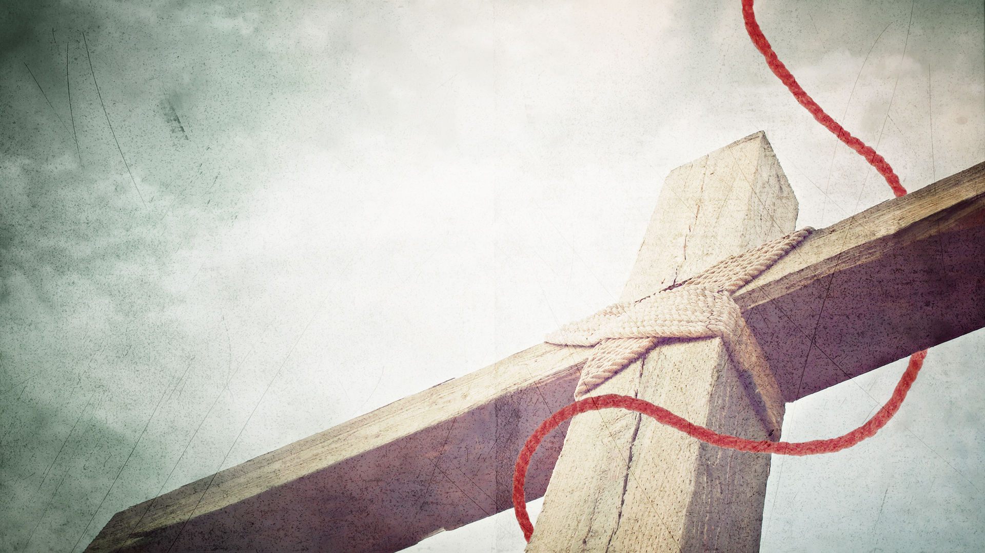
LESSON SUMMARY
“I must act in a holy manner, not for reward or appearance, but because of God’s nature. The Law continually reminds me that commandments are to be kept, not for their own sake, but for God’s sake. I will be righteous then, because God’s nature is such. His character determines my conduct.”
~ Jim Elliot (1927-1956)

Slide 6
LESSON SUMMARY
The sin offering and the guilt offering were mandatory for God’s children to live in harmony with Him and with one another.
The sin offering represented the purification of the people before God. The guilt offering served to “repair” the damage caused by sin and cleanse the offender’s conscience.
These offerings pointed forward to Jesus Christ, whose work purifies our hearts, cleanses our consciences, and frees us to do good deeds for His glory.

Slide 7
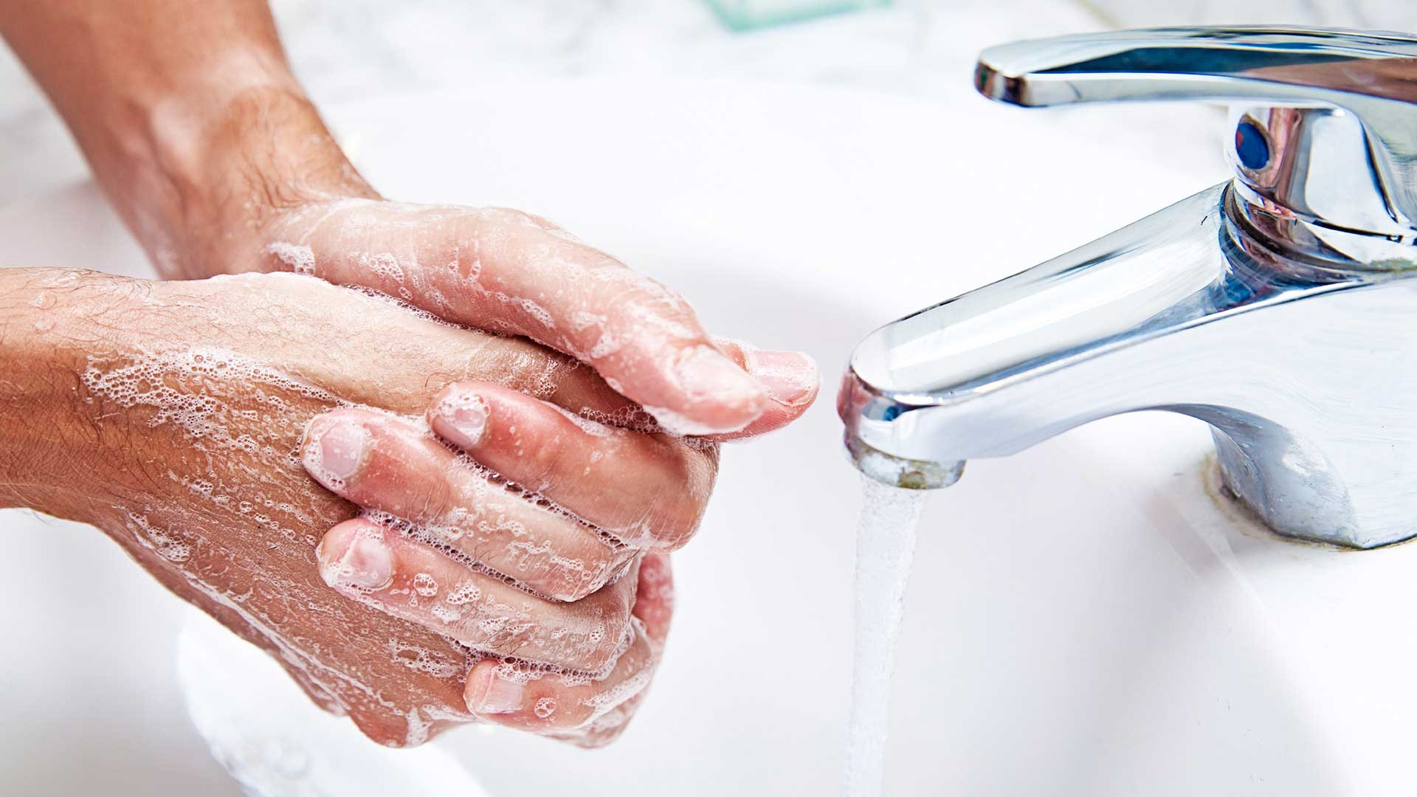
INTRODUCTION
The Lord was interested in preserving the purity of His people because He wanted their hearts to reflect His heart.
These stringent categories of “clean” and “unclean” helped get across God’s holiness.
For the Israelites, cleanliness was truly next to godliness.

Slide 8
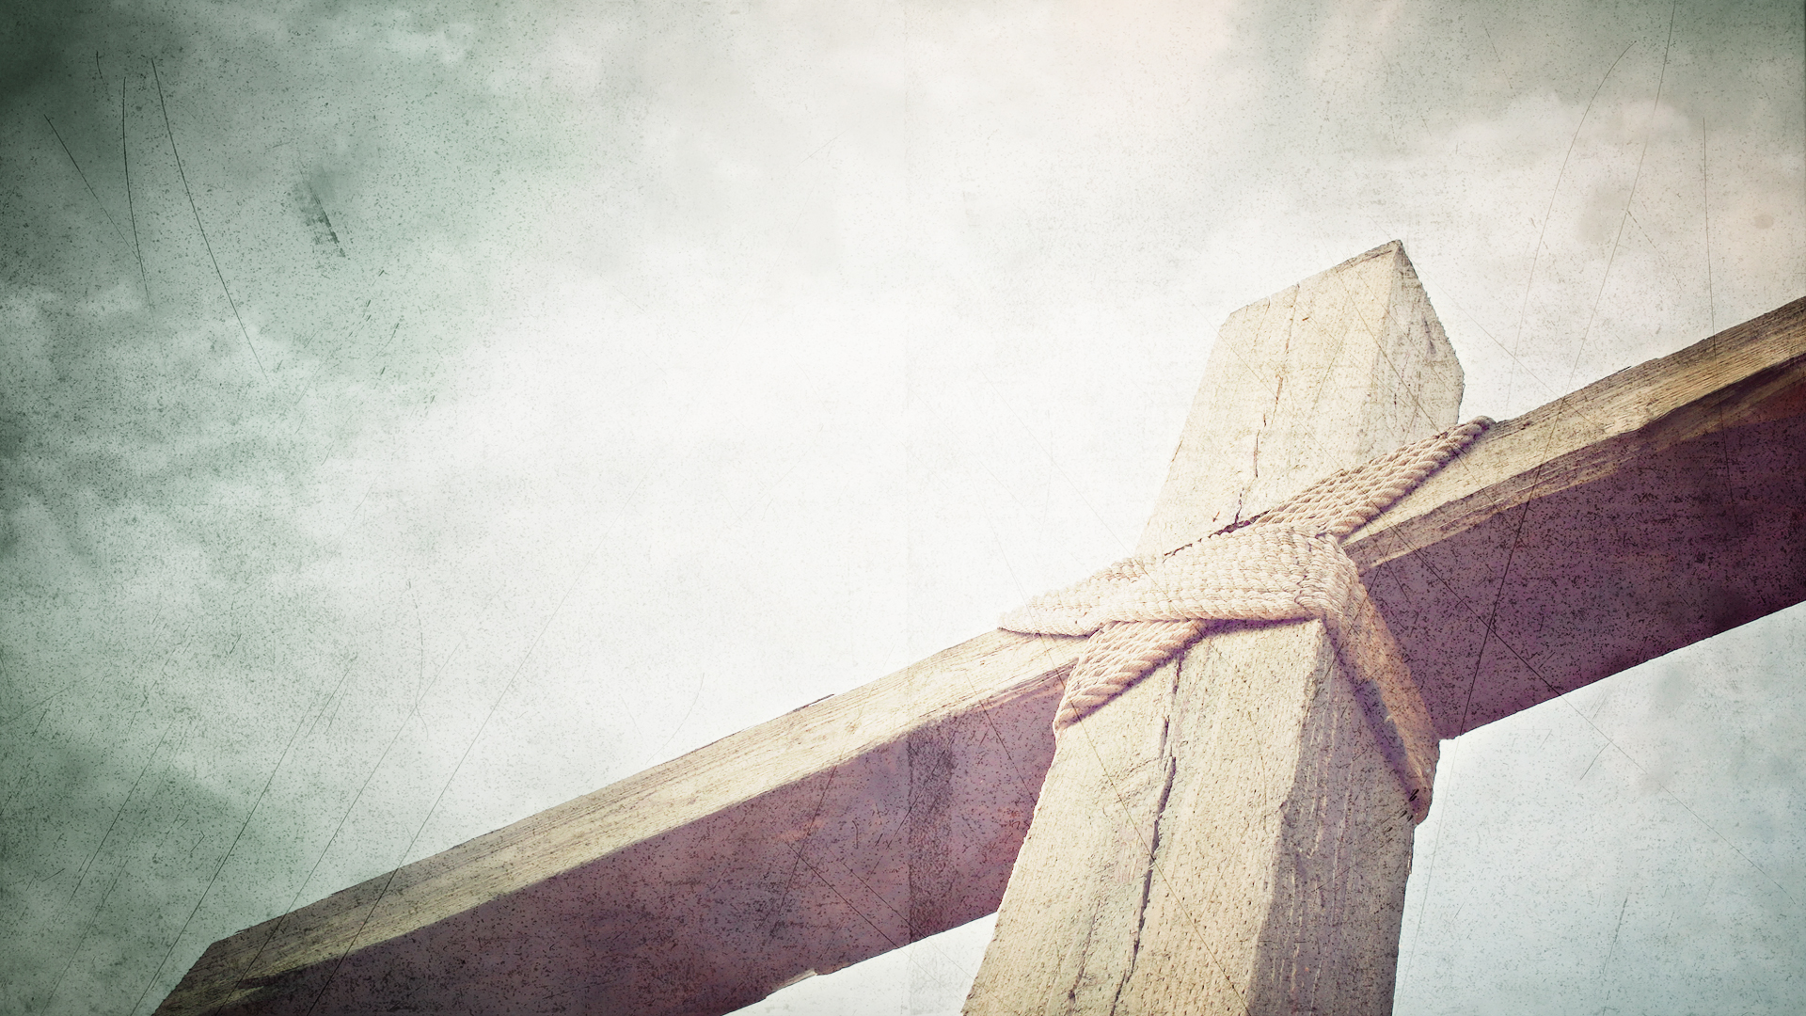
We need atonement to purify our hearts (Leviticus 5:1-13; Hebrews 13:11-12).
God takes holiness seriously. He wants His people to be set apart for His purposes. A holy God desires a holy people.
The sin offering was God’s provision of purification for those who were unclean.
Before the guilty party offered the animal to the priest to be sacrificed, confession had to occur.

Slide 9
We need atonement to purify our hearts (Leviticus 5:1-13; Hebrews 13:11-12).
The sin offering was designed to transfer the “uncleanness” of the worshiper to the animal being sacrificed.
The sin offering points ahead to Jesus, who became the sin offering in our place in order to purify our hearts and make us holy (Heb. 13:11-12).

Slide 10
We need atonement to purify our hearts (Leviticus 5:1-13; Hebrews 13:11-12).
For the bodies of those beasts, whose blood is brought into the sanctuary by the high priest for sin, are burned without the camp. Wherefore Jesus also, that He might sanctify the people with His own blood, suffered without the gate.
(Hebrews 13:11-12)
Application: When you and I accept the great transfer, our filth is replaced with faith. Our guilt is exchanged for grace. Jesus takes our contamination, and in return, we take His cleanliness. In the Father’s eyes, you and I are as pure and holy as Jesus Himself.

Slide 11
We need atonement to cleanse our consciences (Leviticus 5:14-19; Hebrews 9:13-14).
The guilt offering alleviated the consciences of those whose sin damaged others.
This offering was intended to restore the relationship of the offender with the victim. In doing so, the conscience was cleansed and the community was restored.
The New Testament shows how Christ’s atoning work cleanses our consciences so we are freed to serve God on His mission (Hebrews 9:13-14).

Slide 12
We need atonement to purify our hearts (Leviticus 5:1-13; Hebrews 13:11-12).
For if the blood of bulls and of goats, and the ashes of an heifer sprinkling the unclean, sanctifieth to the purifying of the flesh: How much more shall the blood of Christ, who through the eternal Spirit offered Himself without spot to God, purge your conscience from dead works to serve the living God?
(Hebrews 9:13-14)
Application: Service is the only appropriate response to reparation. When we are truly aware and appreciative of the gracious gift of God, our gratitude will drive us to share this gift of grace with others. The blessing of a clean conscience must overflow into blessing for an unclean world!

Slide 13
CONCLUSION
Name | Reference | Elements | Significance
Burnt Offering | Leviticus 1; 6:8-13 | Bull, ram, male goat, male dove, or young pigeon without blemish (Always male animals, but species of animal varied according to individual’s economic status) | Voluntary; signifies propitiation for sin and complete surrender, devotion, and commitment to God
Grain Offering | Leviticus 2; 6:14-23 | Grain, flour, or bread (always unleavened) made with olive oil and salt; or incense | Voluntary; signifies thanksgiving for firstfruits
Peace Offering | Leviticus 3; 7:11-36; 22:17-30; 27 | Any animal without blemish (Species of animal varied according to individual’s economic status) | Voluntary; symbolizes fellowship with God

Slide 14
CONCLUSION
Name | Reference | Elements | Significance
Sin Offering | Leviticus 4:1-5:13; 6:24-30; 12:6-8 | Male or female animal without blemish (Species of animal varied according to individual’s economic status) | Mandatory; made by one who had sinned unintentionally or was unclean in order to attain purification
Guilt Offering | Leviticus 5:14-6:7; 7:1-6; 14:12-18 | Ram or lamb without blemish | Mandatory; made by a person who had either deprived another of his rights or had desecrated something holy

Slide 15
CONCLUSION
Purification and restitution always lead to evangelization.
The sacrifices of the Old Testament are incredibly relevant for us today. They send us to Jesus, who sends us to the world!

Slide 16
LOOKING AHEAD
LESSON 6
Water from
the Rock
Exodus 17

