Slide 2
LESSON 11
The Bread of Life
John 6:25-58

Slide 4
OVERVIEW
Garden Coverings
Abraham & Isaac
The Passover
OT Sacrificial Offerings
Water from the Rock
Bronze Serpent
Sign of Jonah
Suffering Servant
Lamb of God
Bread of Life
Perfect Sacrifice
Washed Robes

Slide 5
LESSON SUMMARY
One of the places we see the Scriptures use the concept of food to illustrate true things about God is in the Gospel of John.
Using the example of God’s provision of manna for Israel in the wilderness, Jesus claimed to be the Bread from heaven who gives life to the world.
The work God requires of us is to believe in Christ, who has given His body and blood as a sacrifice for our salvation. As we are joined to Jesus, we are sent to the world in the way the Father sent His Son.

Slide 6
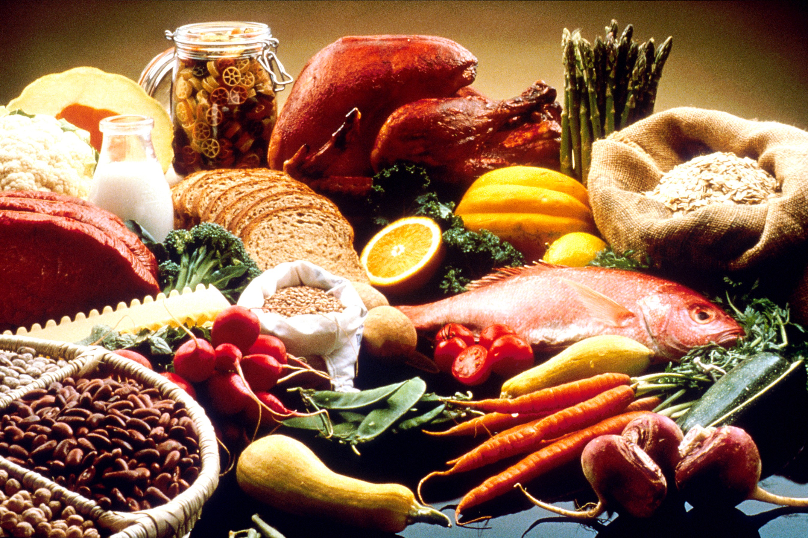
INTRODUCTION
We need food to survive, but God also gave us taste buds. Food is not just fuel. It is also for our enjoyment and delight.
The biblical writers often turned to the metaphor of food to explain and illustrate various gospel truths.
“You need Jesus—not some creed, code, or cause. You don’t go beyond Jesus. You may go deeper into Jesus, but you’ll never go beyond Jesus. The table is set. Come and dine.” ~ Adrian Rogers (1931-2005)

Slide 7
The Bread from heaven gives life to the world (John 6:25-34).
John uses the Old Testament image of manna to point to Jesus.
After feeding thousands of people in the wilderness, Jesus urged the people to look for the Bread that comes from heaven, not the bread of earth that spoils.
The manna was never meant to fully satisfy the people of God while they were in the wilderness because the wilderness was not their home.

Slide 8
The Bread from heaven gives life to the world (John 6:25-34).
“Christ is our Bread; because Christ is Life, and bread is life.” ~ Tertullian (circa 160-225)
Application: Too often, you and I make the same mistake of looking to the appetizer for satisfaction instead of looking to God to sustain us forever. We look for satisfaction in God’s gifts and fail to see that His gifts point us to His promises. We must find satisfaction in Christ alone, not in the appetizers He gives us in this life.

Slide 9
Jesus is the Bread of life from heaven (John 6:35-51).
Jesus, the Bread of life, is imperishable. He promised that whoever comes to Him in faith will never be hungry again.
Jesus is the true manna, the miracle provision of food from heaven.

Slide 10
Jesus is the Bread of life from heaven (John 6:35-51).
“We are all when we pray God’s beggars…What does the beggar ask of thee? Bread. And what dost thou ask of God, but Christ, who saith, ‘I am the living Bread which came down from heaven’?” ~ Augustine (354-430)
Application: Even when the Israelites were given the provision of the manna in the wilderness, they grumbled and longed for the days when they ate pots full of meat, leeks, and garlic. They forgot those hearty meals came at the price of slavery. Our problem, like theirs, is that even when we have been delivered from the things that once ruled over us and enslaved us, we can still wish we were back in chains.

Slide 11
Eternal life is found only in the sacrifice of Jesus (John 6:52-58).
Jesus used the stark images of His body and blood in order to get across our need for salvation in Him. Eating His body and drinking His blood is another way of saying we trust in His death and we receive His life.
The Bible promises us that if we have united ourselves with Christ in a death like His, most certainly we will be united with Him in a resurrection like His.

Slide 12
Eternal life is found only in the sacrifice of Jesus (John 6:52-58).
We live through faith in Jesus Christ, the One sent from the Father. Likewise, we serve through faith in Jesus, the One sent to serve His people.
“There is a hunger in the human heart that none but Christ can satisfy. There is a thirst that none but he can quench.” ~ John Stott (1921-2011)

Slide 13
CONCLUSION
The term Christian literally means “little Christ.” We should behave in the world as He did. We are to love as He did, suffer as He did, serve as He did. As Christ imitated the Father, so we ought to imitate Christ.
Jesus Christ is the Bread of life from heaven, the One in whom we are sustained and satisfied. Energized by His Spirit, we move forward for His kingdom, representing Christ the King, urging the hungry and needy to turn to Christ for salvation.

Slide 14
LOOKING AHEAD
LESSON 12
Atonement-
Driven Life
Heb. 10:19-25

