Slide 2
What is Islam? A Comprehensive System of Thought and Life, a Replacement Civilization, and a distinct Legal System within which is a religion.
Notes:
Key point – Islam is NOT first and foremost a religion. It is a comprehensive political and legal system. This is how it has always been since Muhammad migrated to Medina in 622 AD.
This is the single most important concept that all Americans and Christians in particular need to understand.

Slide 3
Research Sources
Works written by Muslims for Muslims
Works written by Muslims for non-Muslims
Works written by non-Muslims for non-Muslims
Works written by former Muslims for non-Muslims
Notes:
As I began my study after 9/11, I quickly realized the need to carefully select what I read. For the most part, I use resources which are written for Muslims by Muslims. The other sources I use only for insight or because they are in the mainstream and I need to know what is being said by the pundit crowd.

Slide 4
Current Events
Notes:
A quick look at local current events hopefully will stir your awareness.

Slide 5
What is the relationship between the following attacks?
9/11
Paris
Istanbul
Bangladesh

Slide 6
Islamic Conquest
Notes:
All of this land is viewed as Muslim land, eternally from a Muslim perspective. We are looking at 129 years of military advance.

Slide 7
Battles with Islam
Battle of Tours – 732AD Charles Martel
Battle of Granada – 1492AD
Siege of Vienna – 1529AD
Battle of Lepanto – 1571AD
Battle of Vienna – 1683AD
Notes:
Tours – Charles Martel stopped the march of Islam across Europe from the west.
The Battle of Granada ended Muslim domination of Spain.
The Holy Roman Empire was at war with Islam on the east and the west for nearly 1,000 years.
What is important is that this is not a new conflict which just happened. It is a longstanding war.

Slide 8
Ottoman Empire – 1580 AD
Notes:
The shrinkage of the Muslim lands is an embarrassment or a breach of honor for Muslims.

Slide 9
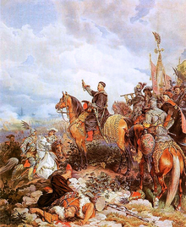
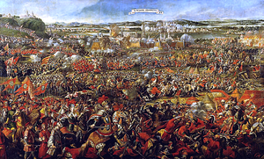
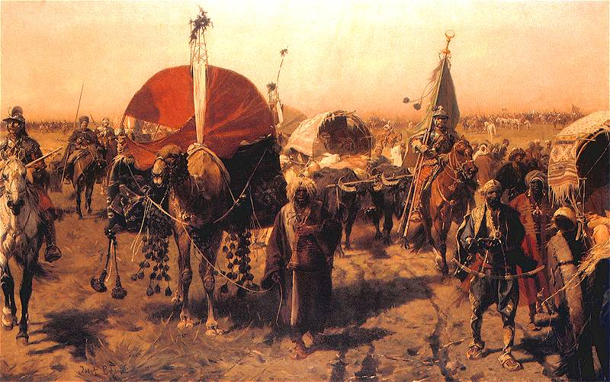
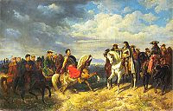
Battle of Vienna September 11-12, 1683AD
Notes:
Polish King John Sobieski meeting Leopold & Blessing Polish attack
Polish army returning with loot of the Ottoman forces

Slide 10
Ottoman Empire – 1699 AD
Notes:
Note the northern boundary just south of Vienna and that Islam has been driven from Spain.

Slide 11
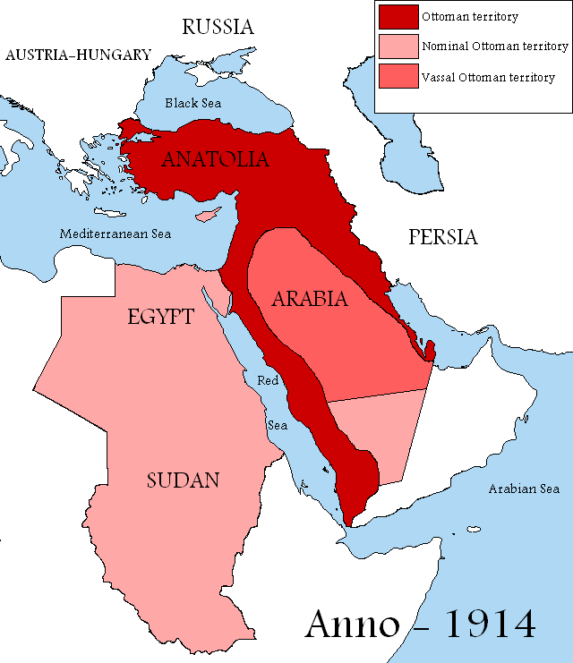
Ottoman Empire – 1914 AD
Notes:
This is what the Ottoman Empire looked like at the beginning of the 20th C. Note how little was actually under the control of the Caliphate.

Slide 12
Definitions – the system
Islam – literally = submission to Allah or slave of Allah
Muslim – a person who submits to Allah
Ummah – worldwide community of Muslims
Caliph – title for the leader of the Islamic Ummah
Ulema – Muslim scholars trained in Islamic Law
Notes:
This an initial list of key words. It is important to use these terms accurately when talking to a Muslim.

Slide 13
Definitions - sources of authority
Quran – the final divine guidance and moral direction for mankind which is unalterable
Sira – example of Muhammad – his biography
Hadith – words and deeds of Muhammad
NOTE: The Sira and the Hadith together are the Sunnah
Notes:
This trilogy of texts carefully codifies how a Muslim lives. It provides excruciating details about such things as which shoe to put on and take off first. Because for a Muslim life is all about mirroring the example set by Muhammad.

Slide 14
Islamic Fundamentals Corpus Juris of Islamic Law
Qur’an – direct uncreated revelation
Tafsīr – commentary on the Quran
Sīrah Rasūl Allāh – usual habits and practices of Muhammad or the biography of the Messenger
Hadith – narration on the words and deeds
Shari’ah jurisprudence – law of all Islamic lands
Shari’ah policy – government in accordance with the goals and objectives of Shari’ah and in its widest sense applies to all government policies
Notes:
Are these our founding documents?
Next we are going to walk through the Quran in greater detail, explain how to use it and then look at the Haddith and finally a look at Sharia Law with an emphasis on it as the Law of the Land.

Slide 15
The Periods of Quranic Revelation
Middle Meccan 18% (21)
Late Meccan 18% (21)
Medinan 21% (24)
Early Meccan 42% (48)
Notes:
The surah or chapters of the Quran record a pattern of transition. Unfortunately, however, when we open a Quran, we find an anthology that is not compiled chronologically. Rather it is compiled based on length of the surah.
If read chronologically, the transition from peaceful coexistence to political violence becomes clear. There is also an attitude change regarding how Muslims are to treat the infidels (Christians, Jews and others).
Terms like jihad gain clear boundaries, applications and unambiguous definitions. This is not understood until one reads the Quran in a chronological manner. The clarity increases further when one reads the sunnah and the hadith.
The Early Meccan surahs are very peaceful. The later Medinan surahs are full of violence and these abrogate the earlier passages.

Slide 16
The Islamic “Bible”
Islam is 14% Allah and 86% Mohammed

Slide 17
Amount of Text Devoted to Kafir Kafir = non-muslim
Notes:
Who are the kafir?
People of the Book = “Christians” who believe in Allah, the last Prophet, and deny the trinity, the incarnation and the crucifixion of Christ and that Christ will return to establish Shari'a Law. “Jews” who believe the Torah is corrupt and that Muhammad is the last in the line of Jewish prophets.
Dhimmi – a non-Muslim who willingly submits to the dictates of Islam and refuses to say or do anything that is critical of Allah, Muhammad or the Quran and offends a Muslim. Political Correctness or Islamophobia.

Slide 18
Definitions - sects
Sunni Islam:
Largest sect (80-90%),
Leadership succession is a function of elected community consensus – Muftis and Mullahs
Shia Islam:
Leadership succession as a matter of direct family lineage to Muhammad – Imams & Ayatollahs
Anticipates the return of the Mahdi
Sufi Islam – mystics
Salafi Islam – adherants to the earliest fundamentals
Notes:
A word of caution here. Muslims like to divert the conversation or allow the conversation to divert to a sectarian discussion because this takes the focus off that which is settled among ALL of the sects, which is 85-95% of revealed truth in Islam. There is no disagreement about the relationship of Muslims to non-Muslims.
The sect debate is the internecine debate or the squabble among Muslims. Try to keep the discussion on what the Quran itself says and what is settled hadith.
Let the Muslims debate the sects issues among themselves.

Slide 19
Definitions – schools of law
Sunni Schools of Law
Hanafi
Hanbal
Malik
Shafi’I
Shia Schools of Law
Usuli
Akhbari
Shayki
Notes:
Within Islam, there are 7 primary schools of Islamic Law. Among these schools consensus exists at the 85-95% level. The importance of this reality will become clearer as we move along.
The major differences between the Sunni and Shia relate to succession within Islam and the expected return of the Mahdi as well as a few practice issues. Do not attempt to get in the middle of this debate. Jesus was able to divide the Sadducees and Pharisees, we are not quite that wise.

Slide 20
Sunni Islam
Hanafism
Malikism
Shafism
Hanbalism
622 AD
Takfirism
Circa 750 AD
Wahhabism
Circa 1300 AD
Ibn Taymiyya (Takfiri)
Circa 1750 AD
Abd al-Wahhab

Slide 21
Definitions – the legal structure
Sharia – derived from the Quran and Sunnah
Fiqh – legal understandings which extend the Shariah
Fatwa – legal opinions or the means to implement the Sharia
Ijma – consensus of the scholars
Ijtihad – process of legal reasoning
Dawah – inviting unbelievers to Islam
Notes:
Dawah is a rough equivalent to evangelism in Christianity.

Slide 22
Naskh or Abrogation
There is, no naskh after the demise of the Prophet. But during his lifetime, there were instances when some of the rulings of the Qur’an and Sunnah were either totally or partially repealed by subsequent rulings. This was due mainly to the change in circumstances in the life of the community and the fact that revelations of the Qur’an spanned a period of twenty three years.
Muhammad Hashim Kamali, Principles of Islamic Jurisprudence
The law was laid down in the period of the Prophet (peace be unto him) gradually and in stages. The aim was to bring a society steeped in immorality to observe the highest standards of morality. This could not be done abruptly. It was done in stages, and doing so necessitated repeal and abrogation of certain laws.
Imran Ahsan Khan Nyazee, Islamic Jurisprudence
Notes:
Abrogation is principle used to accurately understand Islam as it codifies the level of authority of each surah or chapter.
Dr Kamali served as the Chairman of the Constitutional Review Commission of Afghanistan in 2003, was trained in Islamic Law at the Univ of Kabul. He then served as an Assoc. Prof and subsequently as a Public Prosecutor with the Ministry of Justice, Afghanistan. Currently he is the CEO and Chairman of the International Institute of Advanced Islamic Studies, Malaysia.
Dr . Nyazee is currently in charge of training and publications at the Shari’ah Academy, a unit of the International Islamic University, Islamabad, Pakistan.
Sharia Law is real law and it is foreign law in the US.

Slide 23
Scholarly Consensus (ijma’)
Scholarly consensus (ijma’) is the agreement of all mujtahids of the Muslims existing at one particular period after the Prophet’s death about a particular ruling regarding a matter or event.
When the four necessary integrals of consensus exists, the ruling agreed upon is an authoritative part of Sacred Law that is obligatory to obey and not lawful to disobey. Nor can mujtahids of a succeeding era make the thing an object of new ijtihad, because the ruling on it, verified by scholarly consensus, is an absolute legal ruling which does not admit of being contravened or annulled.
Al-Misri, Book B, “The Validity of Following Qualified Scholarship," at b7, 1-2.
Notes:
Al-misri’s text, Reliance of the Traveler, was published circa 1350 AD. The age and reliability of this text is important when discussing the historicity of consensus within Islam.
A Mujtahid is an Islamic legal authority
In Sunni Islam in particular, only a legitimate mujtahid may issue a legal decision. Knowing this helps to knock down the argument that there are many versions of Islam. This is another deliberate distraction.
Note the specific requirements and the consequences of a ruling in Islamic Law.
This principle of consensus is critical to addressing the myth that there are many versions of Islam. There is only one version of Islam. Do not let the Shia/Sunni divide confuse you. More on this in a few minutes. Islamic Law is Islamic Law.

Slide 24
“It is the nature of Islam to dominate, not to be dominated, to impose its law on all nations and to extend its power to the entire planet.”
Hasan al-Banna
Founder of the Muslim Brotherhood
Notes:
This statement is accepted truth by any Muslim who is serious about his belief because it is a summary of the Muhammad’s exhortations and Muhammad is the perfect example for all Muslims.
Muslims really believe this and are acting accordingly.
What I trust you will leave with today is more than an understanding but rather an appreciation of the fact the Muslims are organized, have a creed, principles, stated objectives and a plan.
The plan in the US is to destroy democracy by using democracy and ultimately replace the Constitution and Christianity with Islamic Law and Islam as the sole religion of the Land.

Slide 25
Muslim Brotherhood
Objective in the U.S.
“The Ikhwan must understand that their work in America is a kind of grand jihad in eliminating and destroying the Western Civilization from within and ‘sabotaging’ its miserable house by their hands and the hands of the believers so that it is eliminated and God’s religion is made victorious over all other religions”
Notes:
This is a direct quote from a Muslim Brotherhood document.
This May 1991 memo was written by Mohamed Akram, a.k.a. Mohamed Adlouni, for the Shura Council of the Muslim Brotherhood. In the introductory letter, Akram referenced a "long-term plan…approved and adopted" by the Shura Council in 1987 and proposed this memo as a supplement to that plan and requested that the memo be added to the agenda for an upcoming Council meeting. Appended to the document is a list of all Muslim Brotherhood organizations in North America as of 1991.
This is one of the documents introduced into evidence in the Holy Land Foundation Trial which we will look at in a few minutes.

Slide 26
Hajj Amin al Husseini
Notes:
Who are the two men in this picture?
Hitler and the Grand Mufti of Jerusalem.
Does it surprise you that they would be meeting?

Slide 27
Husseini and Hanzar Division
Notes:
This is the SS Division which nearly exterminated the Jews in the Balkans.

Slide 28
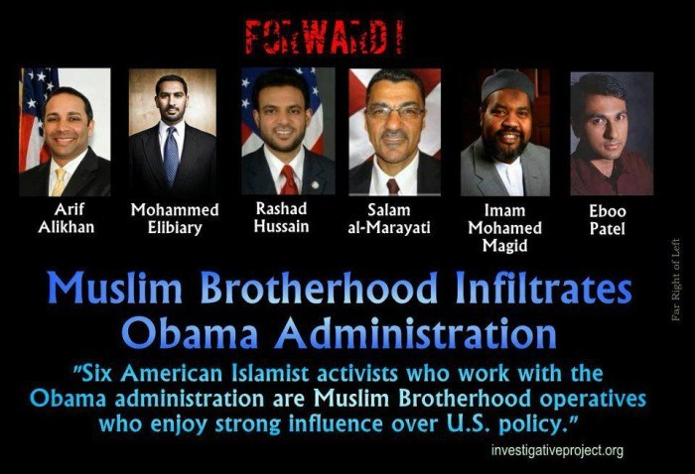
International Institute of Islamic Thought (IIIT) and the US Government
Secretary of DHS
Jeh Johnson

Slide 29
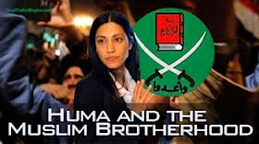
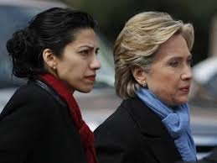
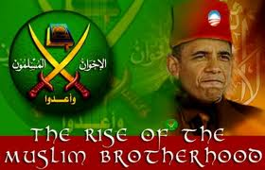
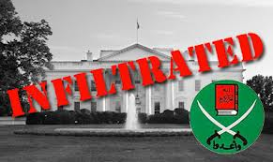
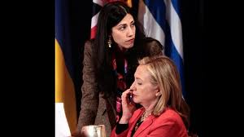
Who is Huma Abedin?

Slide 30
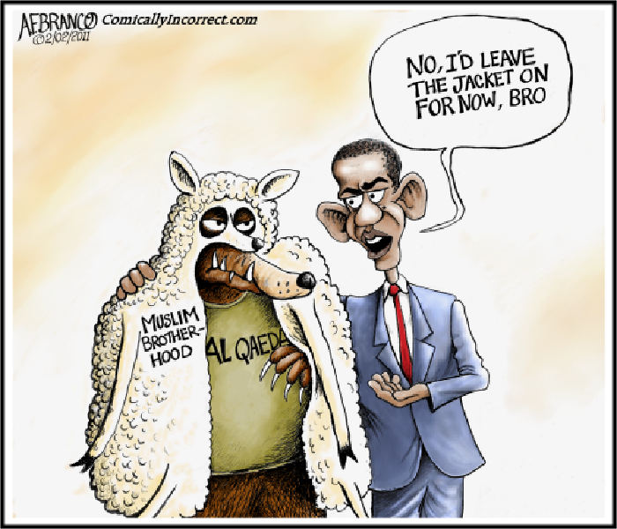

Slide 31
What then is Islam?
Islam is a geo-political ideology and a replacement religion and civilization
Islam the religion is what a Muslim does to go to Paradise
Islam the political, economic, military and social system determines the treatment of unbelievers, hypocrites and apostates – the kafirs
Islam is governed by Islamic Jurisprudence or Sharia Law, not Theology
Notes:
The division between church and state does not exist in Islam.
Islam is a land-based religion. Once a parcel of land has been conquered by Islam, the land eternally belongs to Islam. The world is thus divided into the dar al Islam and dar al harb, or the land of submission and the land of war. Infidels or unbelievers rule in the dar al harb. Thus the US is the land of war because the Law of the Land in the US is not Sharia.
Islam is a political system. The “undisputed rule of Islam” or Sharia Law is intended to be universal.
Islam is a replacement religion. Every major event in the Old Testament and New Testament to include God’s covenants with man is either replaced entirely or are substantially redefined in Islamic writings. Ishmael replaces Isaac, Jesus the God-man is replaced with Jesus the man, the Bible is replaced with the Quran, etc.
Islam is a religion of law not theology. That is, it is a religion of works not grace.

Slide 32
The United States
The People (All, equally)
Power flow
The Constitution
Executive
Judicial
Legislative
Government
Religious entities, business, clubs, groups, etc
Notes:
Note the stark differences

Slide 33
Global Islamic State
Shari’ah
Executive
Judicial
Government
Legislative
The People (Men)
Power flow
The People (Women)
Large gap
kafirs, dhimmis & other non-Muslims
Notes:
Take a good look at this. Does this look like what we have here in the US? This is the structure prescribed by Sharia.
Here is why this necessary from an Islamic perspective. For a Muslim to swear allegiance to a legal system, a constitution, a nation, other than Allah, the Quran, the last prophet, Muhammad and the Sharia is to do what Allah has prohibited. Thus the Muslim is worthy of death and eternal damnation to hell, unless he is doing so to deceive the non-Muslim (you and me) and to further Islam and the imposition of Sharia, to replace the civilization and in the case of America, to replace all religions and the Constitution.

Slide 34
Scholarly Consensus - Today
o9.3 Jihad is also personally obligatory for everyone able to perform it, male or female, old or young when the enemy has surrounded the Muslims on every side, having entered our territory, even if the land consists of ruins, wilderness, or mountains, for non-Muslim forces entering Muslim lands is a weighty matter that cannot be ignored, but must be met with effort and struggle to repel them by every possible means.
Umdat al Salik, Book O “Justice,” § 9 “Jihad”
All the schools of Islamic jurisprudence - the Sunni, the Shiite… and all the ancient and modern schools of jurisprudence - agree that any invader, who occupies even an inch of land of the Muslims, must face resistance. The Muslims of that country must carry out the resistance, and the rest of the Muslims must help them. If the people of that country are incapable or reluctant, we must fight to defend the land of Islam, even if the local Muslims give it up.
Yusuf Qaradawi, Qatar TV Sermon, February 25, 2006
Notes:
The first citation is from 1350 AD, the second in from 2006. Note the consistency of argument and how jihad is defined.
Qaradawi’s sermon is available at the MEMRI website.
During one of his widely viewed Qatar TV sermons on February 25, 2006, Qaradawi elucidated <http://www.memritv.org/Transcript.asp?P1=1052> these ideas:

Slide 35
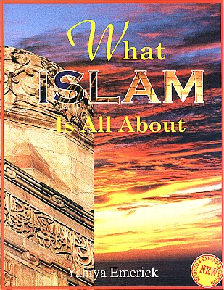
What Islam is All About?
It really is not complicated – even 7th Graders can understand it.
Notes:
Once again, this is being used to teach 7th graders in Islamic Schools in the US.

Slide 36
What is Taught to Muslim Americans in Junior High
What Islam is All About
By Yahiya Emerick
American-born convert to Islam
Widely regarded as a “leading Islamic children’s educationalist in the US
Is the best selling English language Islamic school text for junior high level students in the United States since its initial publication back in 1997
Also wrote The Complete Idiot’s Guide to Understanding Islam
An interesting comparison
Current version the Fifth Revised Printing - June 2004
This is what Muslim 7th graders are taught at the
Mosque and Islamic School in America today!
Notes:
The Complete Idiot’s Guide to Understanding Islam is an example of deliberate deception, similar to the text prescribed for the UNC students.

Slide 37
Elements of Islam
Islam is not just a religion but rather a complete way of life governed by Islamic law which comes from Allah who alone is Sovereign.
Not just a religion but a complete way of life
According to the Qur’an, Islam is the way of life Allah instituted for humanity, even as the rest of the universe submits to His will. (41:11). (Emerick, 50)
Governed by Islamic law
There is no disagreement among the scholars of the Muslims that the source of legal rulings for all acts of those who are morally responsible is Allah Most Glorious. (al-Misri a1.1)
Notes:
If this can be taught to 7th Graders, why don’t leaders in the US Government understand this?

