Slide 1


Slide 2


Slide 3
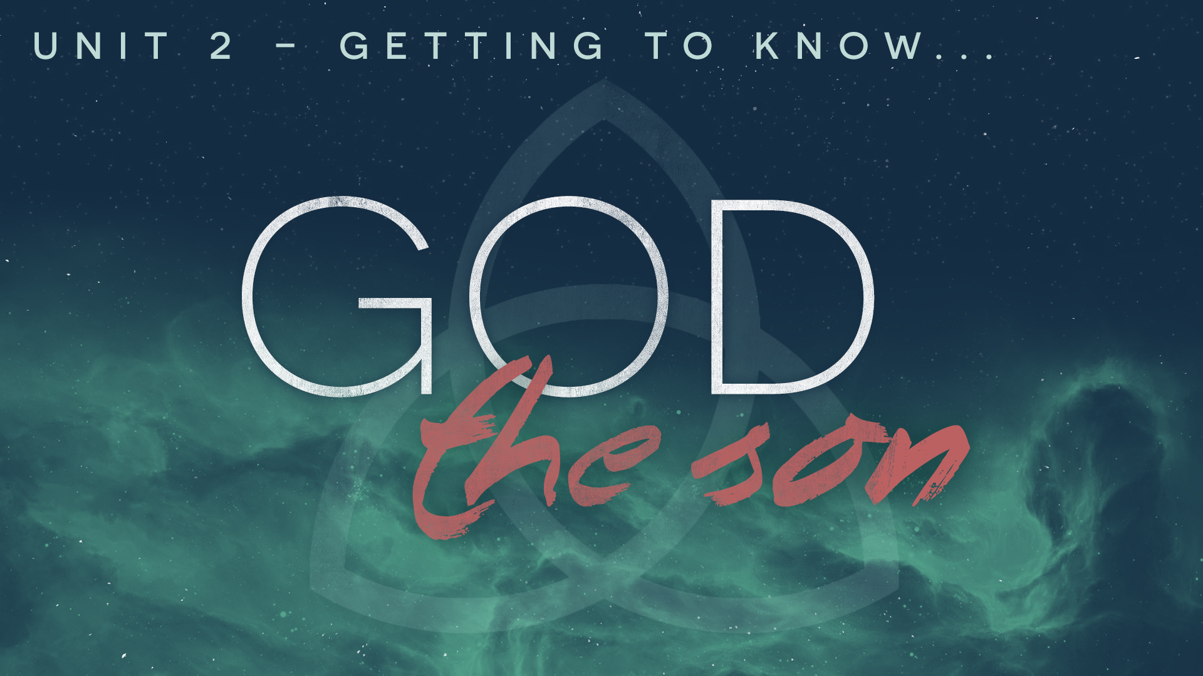

Slide 4
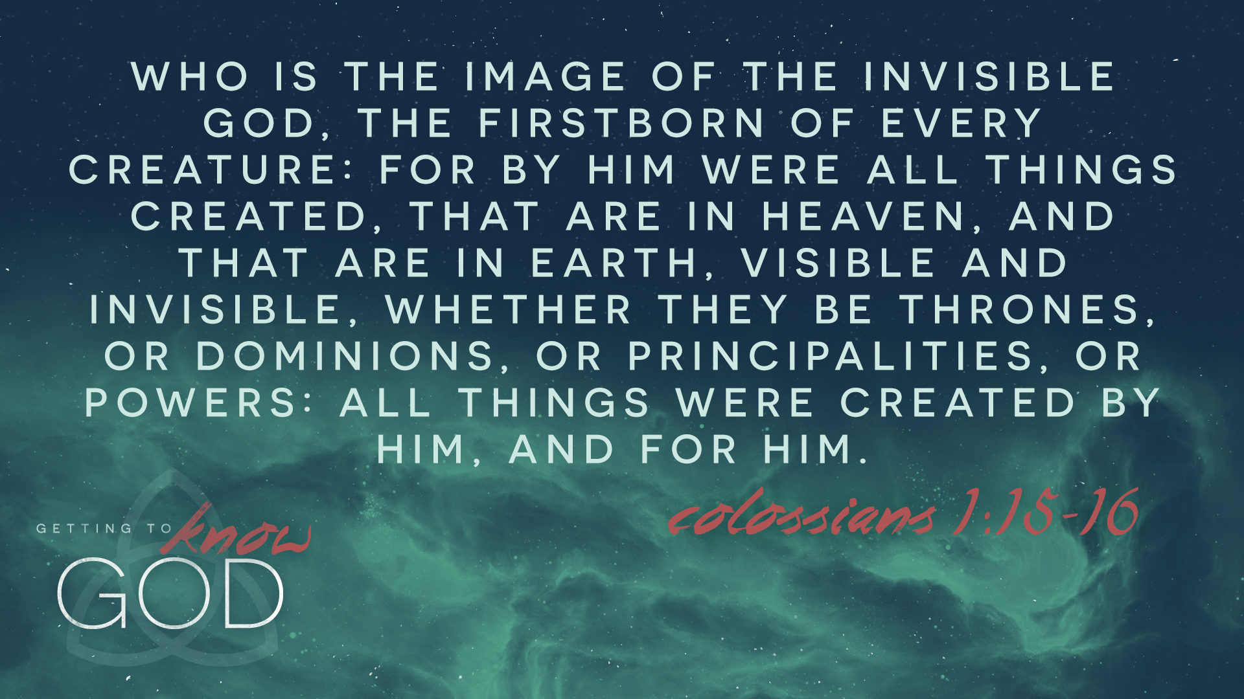

Slide 5
LESSON 9: Jesus’ Work — Prophet, Priest, and King

Slide 6


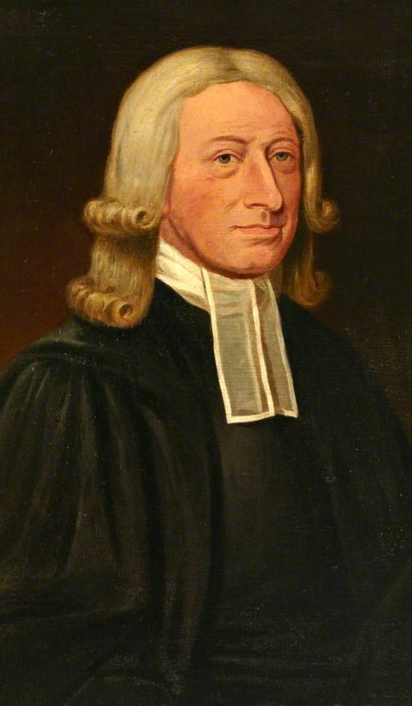
INTRODUCTION
What do you do for a living? What we do often says a lot about who we are.
“I believe that Jesus of Nazareth was the Saviour of the world, the Messiah so long foretold: That being anointed with the Holy Ghost, he was a Prophet, revealing to us the whole will of God: That he was a Priest, who gave himself a sacrifice for sin, and still makes intercession for transgressors: That he is a King, who has power in heaven and in earth, and will reign till he has subdued all things to himself.” –John Wesley

Slide 7

Jesus is the Prophet who reveals God to us (Acts 3:22-26).
The OT prophets delivered God’s message and called people to faith and repentance. Jesus is the greater Prophet who has come into the world. Christ is not merely the messenger but indeed the message.
Jesus is the Word of God (John 1:1, 14).
Jesus is the Truth (John 14:6).
Jesus is God’s revelation (Hebrews 1:1-2).

Slide 8
Jesus is the Prophet who reveals God to us (Acts 3:22-26).
“Jesus is the ultimate Prophet. When He speaks in either word or action, God speaks. What He declares is unabridged truth. To an extent that transcends all previous or future prophets, His words and deeds transform lives and, ultimately, even the cosmos.”
–Paige Patterson
Application: As Christians, we are called to mirror Christ’s prophetic role to the world. By proclaiming the gospel with our words and demonstrating the gospel with our actions, we fulfill our role as salt and light in the world (Matthew 5:13-16).

Slide 9

Jesus is the Priest who reconciles us to God (Hebrews 2:14-18).
The primary responsibility of a priest was to make sacrifices on behalf of the people. But as sinful priests offering animal sacrifices the cycle was never ending. Jesus Christ is the better Priest who offered up a better sacrifice that has truly and fully atoned for sin.
The ministry of Christ is eternal (Hebrews 7:23-25).
The blood of Christ is sufficient (Hebrews 10:4, 10).
The work of Christ is complete (Hebrews 10:11-12).
The sacrifice of Christ is final (Hebrews 10:14).

Slide 10
Jesus is the Priest who reconciles us to God (Hebrews 2:14-18).
Application: As Christians, we are called to mirror Christ’s priestly role. The Bible calls us a royal and holy priesthood (1 Peter 2:5, 9). As priests, our duty is twofold. The first is reconciliation. We must give the gospel and proclaim the sufficiency of Christ for a lost and dying world. And second is intercession. We pray for others, weep for their salvation, and run with arms outstretched to the places where humans need God’s merciful response.

Slide 11
Jesus is the King who reigns over all (Revelation 19:11-16).
Even the greatest of the OT kings would fail (David, Solomon, Hezekiah, & Josiah). Jesus is the better King who will reign in perfect peace and righteousness (Isaiah 9:6-7; Jeremiah 23:5).
Christ rules in the hearts of believers (Matthew 4:17; 12:28).
Christ will fully establish his earthly rule at His Coming (1 Corinthians 15:24-28).

Slide 12
Jesus is the King who reigns over all (Revelation 19:11-16).
Application: As Christians, we share in Christ’s reign (Revelation 22:5). The reign and rule of Christ even today at the right hand of the Father should give the church great confidence in the work with which we have been entrusted. All authority has been granted to the Son (Matthew 28:18). So when we go and proclaim the gospel, we do so in His authority and with the help of the Holy Spirit.

Slide 13
CONCLUSION
A person’s vocation can often tell us quite a bit about that person. So it is with Christ. The Son of God is the greater Moses, the Prophet who mediates the Word of God to us. The Son of God is the greater High Priest, who offered Himself as a propitiation for our sins and now lives to make intercession for His people. The Son of God is the greater David, the King who reigns and rules in perfect righteousness.
“The threefold misery of men introduced by sin—ignorance, guilt, and tyranny and bondage by sin—required this conjunction of a threefold office. Ignorance is healed by the prophetic; guilt by the priestly; the tyranny and corruption of sin by the kingly office. Prophetic light scatters the darkness of error; the merit of the Priest takes away guilt and procures a reconciliation for us; the Power of the King removes the bondage of sin and death. The Prophet shows God to us; the Priest leads us to God; and the King joins us together and glorifies us with God.” –Francis Turretin (1623-1687)

Slide 14
NEXT WEEK: The Person of the Holy Spirit (John 14:16-17)

