Slide 1


Slide 2


Slide 3


Slide 4
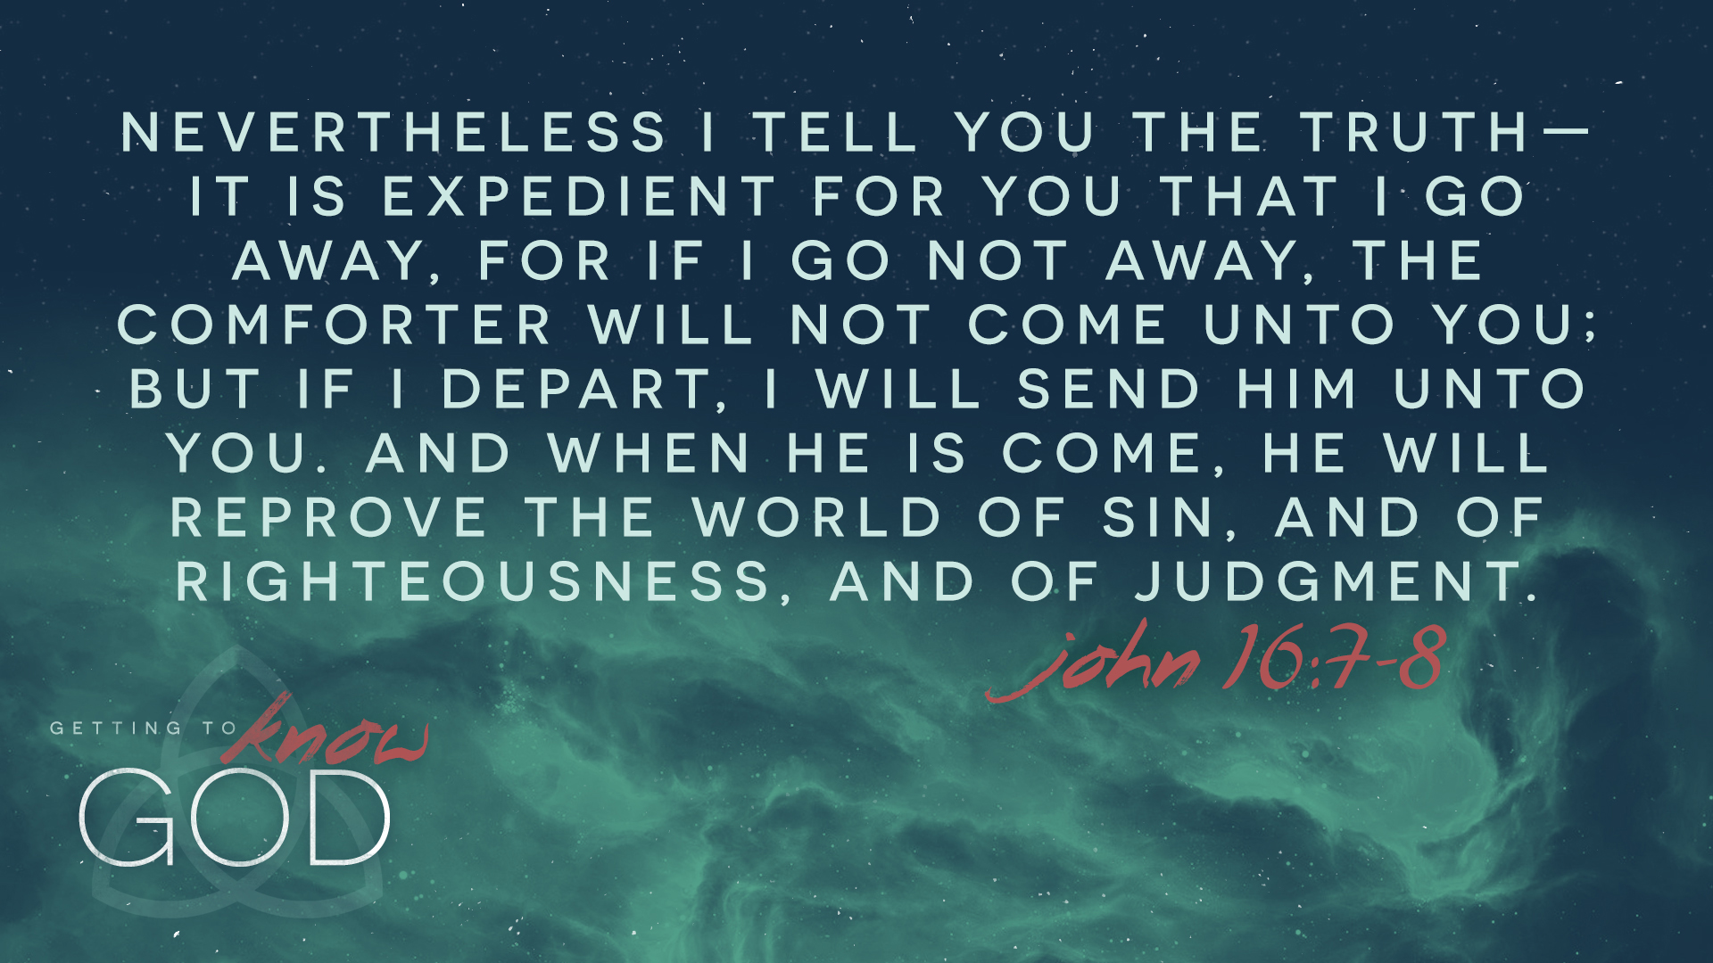

Slide 5
LESSON 12: The Fruit and Gifts of the Spirit

Slide 6


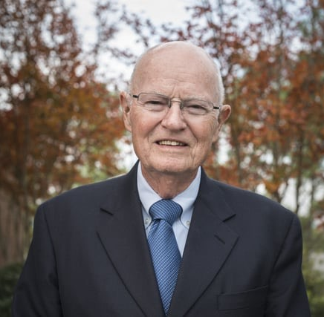
INTRODUCTION
We need the Holy Spirit to reveal God’s truth to us. We cannot grow spiritually without His word in our lives. As believers, we need God to work in us to shape us into the people He has called us to be.
“The more I know [Christ], the more I love Him. The more I love Him, the more I obey Him. The more I obey Him, the more I become like Him. The more I become like Him, the better I know Him. The better I know Him, I love Him the more. And the more I love Him, I reach a new level of likeness to Him.” –Robertson McQuilkin

Slide 7

The Spirit commences God’s work in us (John 3:1-8).
The Spirit convicts of sin and shows the need of a Savior (John 16:8-9).
The Spirit works through the message of the gospel (Romans 10:17).

Slide 8
The Spirit commences God’s work in us (John 3:1-8).
Application: We are called to respond to the Spirit’s work of conviction with repentance (turning from sin) and faith (trusting in the work of Christ alone for our salvation). Being “born again,” or “regenerated,” is not something we can earn with our own good works. We need salvation from above, a spiritual birth that comes from the Holy Spirit Himself.
“Regeneration, or the new birth, is a work of God’s grace whereby believers become new creatures in Christ Jesus. It is a change of heart wrought by the Holy Spirit through conviction of sin, to which the sinner responds in repentance toward God and faith in the Lord Jesus Christ. Repentance and faith are inseparable experiences of grace.” –Article IV from The Baptist Faith and Message, 2000

Slide 9

The Spirit continues God’s work in us.
The fruit of the Spirit (Galatians 5:16-26)
Spiritual fruit is not something we work up by our own power. Spiritual fruit is something the Spirit works out in us by His power. While we can nurture the circumstances for growth, it is the Holy Spirit who is working out Christ’s character in us. The fruit of the Spirit is what the Spirit does in us.
The gifts of the Spirit (1 Corinthians 12:4-11)
Spiritual gifts have been defined as “any ability that is empowered by the Holy Spirit and used in any ministry of the church.” Every believer is given a gift of the Spirit for the purpose of producing what is beneficial for the body of believers and, by extension, the world in need of Jesus (1 Corinthians 12:12-31).

Slide 10
The Spirit continues God’s work in us.
Application: When we engage in ministry that allows us to use our spiritual gifts, we must do so for the glory of God, not the glory of our own name. Whenever we use our gifts in a way that elevates us instead of edifying the church or when the gifts make us look good instead of making God look glorious, we have a problem. But when we exercise our spiritual gifts and involve ourselves in spiritual disciplines, we are raising the sail and readying the boat, and we yield control to the Spirit who works in us.

Slide 11
The Spirit will complete God’s work in us (Ephesians 1:13-14).
We are sealed with the Holy Spirit. His presence in our lives today is the guarantee for our lives tomorrow. The seal gives us confidence in the present and provides hope for the future. He continues to work in us and to keep us, comfort us, and guide us. And the day is coming when the Spirit will complete His work in us. The seal reminds us that God is King and that He assures us of the future hope.

Slide 12
CONCLUSION
The Holy Spirit’s work in us is not merely for our personal
benefit but also for our engagement in God’s mission:
Since the Spirit is the One who convicts people of sin, we ought to fervently pray for the lost, knowing that God alone has the power to save.
Since the Spirit is the One who continues His work in us, we ought to bear the fruit of the Spirit as a testimony to His power and exercise spiritual gifts in a way that equips the church to better fulfill her mission.
Since the Spirit is the One who will complete His work in us, we can move forward with confidence that the purposes of the Lord will be fulfilled.

Slide 13
NEXT WEEK: The Mystery of the Trinity (1 Peter 1:1-2)

