Slide 1
LESSON 4
The Fruit of
Faith, Meekness,
and Temperance

Slide 2
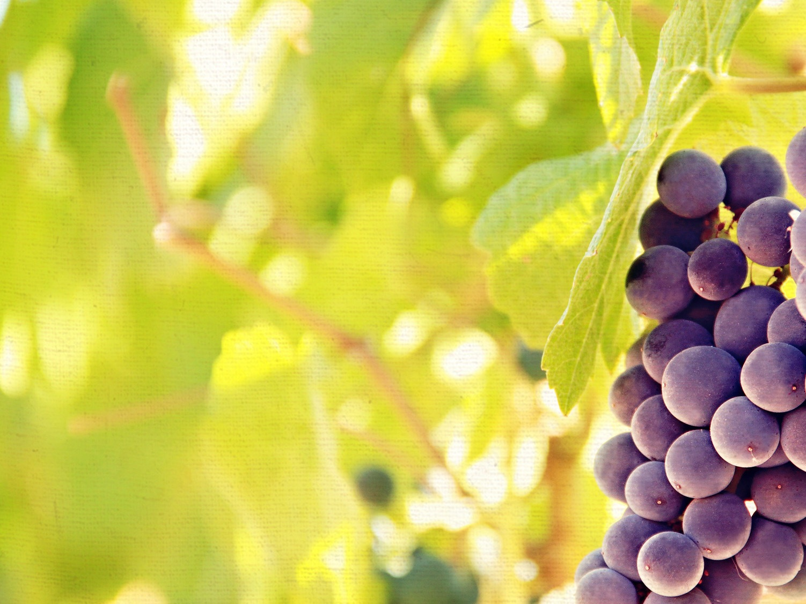
INTRODUCTION
Question: What is the key to spiritual victory and vitality? What is the sole command for the believer in this passage?
Answer: The key and command to bearing spiritual fruit is “walking in the Spirit” (Gal. 5:16).

Slide 3
INTRODUCTION
Question: What does that mean and how do you “walk in the Spirit”?
Answer: Allowing the Spirit of God to take the Word of God to make me more like the Son of God. It is actively filling our minds with Scripture and walking in obedience to God’s revealed truth, therefore allowing the Spirit of God to guide and direct us through His Word. When we “walk in the Spirit” the sinful flesh is subdued and the spiritual fruit is supplied.

Slide 4
INTRODUCTION
Love – the determined act of the will that sacrificially gives of self for the sake of others
Joy – finding my greatest delight in my relationship and position in Christ
Peace – the tranquility of soul because I am rightly related to God and others
Longsuffering – the ability to endure injuries inflicted by others without getting angry and retaliating
Gentleness – kindness in actively working at meeting the needs of others
Goodness – moral and spiritual excellence of life that afflicts the comfortably apathetic and comforts the afflicted around us

Slide 5
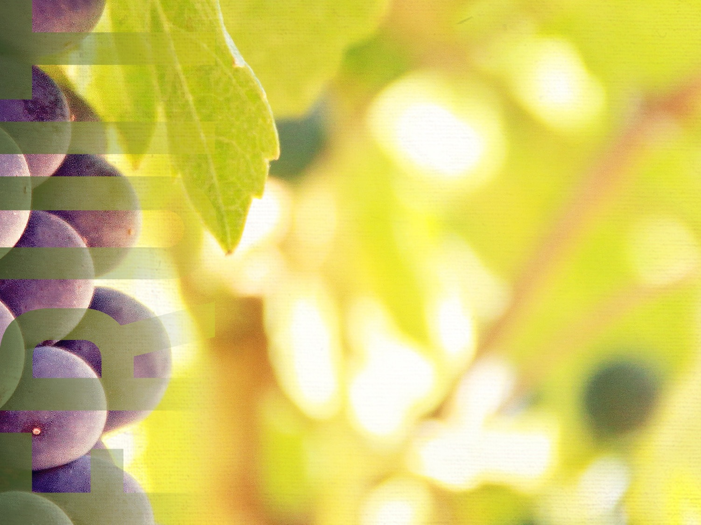
THE FRUIT OF FAITH
Faithfulness is “integrity, honesty, loyalty, or trustworthiness.” It is being someone in whom complete confidence can be placed. This word means to be utterly reliable and true to your word. If I am trusting Christ, others should be able to trust me.

Slide 6
THE FRUIT OF FAITH
The Mandate for Faithfulness
God desires faithfulness (Ps. 51:6).
God admires faithfulness (Mt. 25:21).
God requires faithfulness (I Cor. 4:2).

Slide 7
THE FRUIT OF FAITH
The Model of Faithfulness
There are over 60 references in the Bible to God’s faithfulness. Like Psalm 92:2 which states that God shows forth His lovingkindness in the morning, and His faithfulness every night.

Slide 8
THE FRUIT OF FAITH
The Marks of Faithfulness
Faithful in the small things
If you cannot be trusted with the small things of life, you will be untrustworthy with the big things of life.
Your time
Your treasure

Slide 9
THE FRUIT OF FAITH
The Marks of Faithfulness
Faithful in the small things
Faithful in the secret things
A faithful individual is the same in public and private, at home and church. Their character and conduct are well pleasing to God.

Slide 10
THE FRUIT OF FAITH
The Marks of Faithfulness
Faithful in the small things
Faithful in the secret things
Faithful in the sacred things
For a Christian, all things are sacred because everything we do is to be for the glory of God.
Faithful to your family
Faithful to your friends
Faithful to your faith

Slide 11
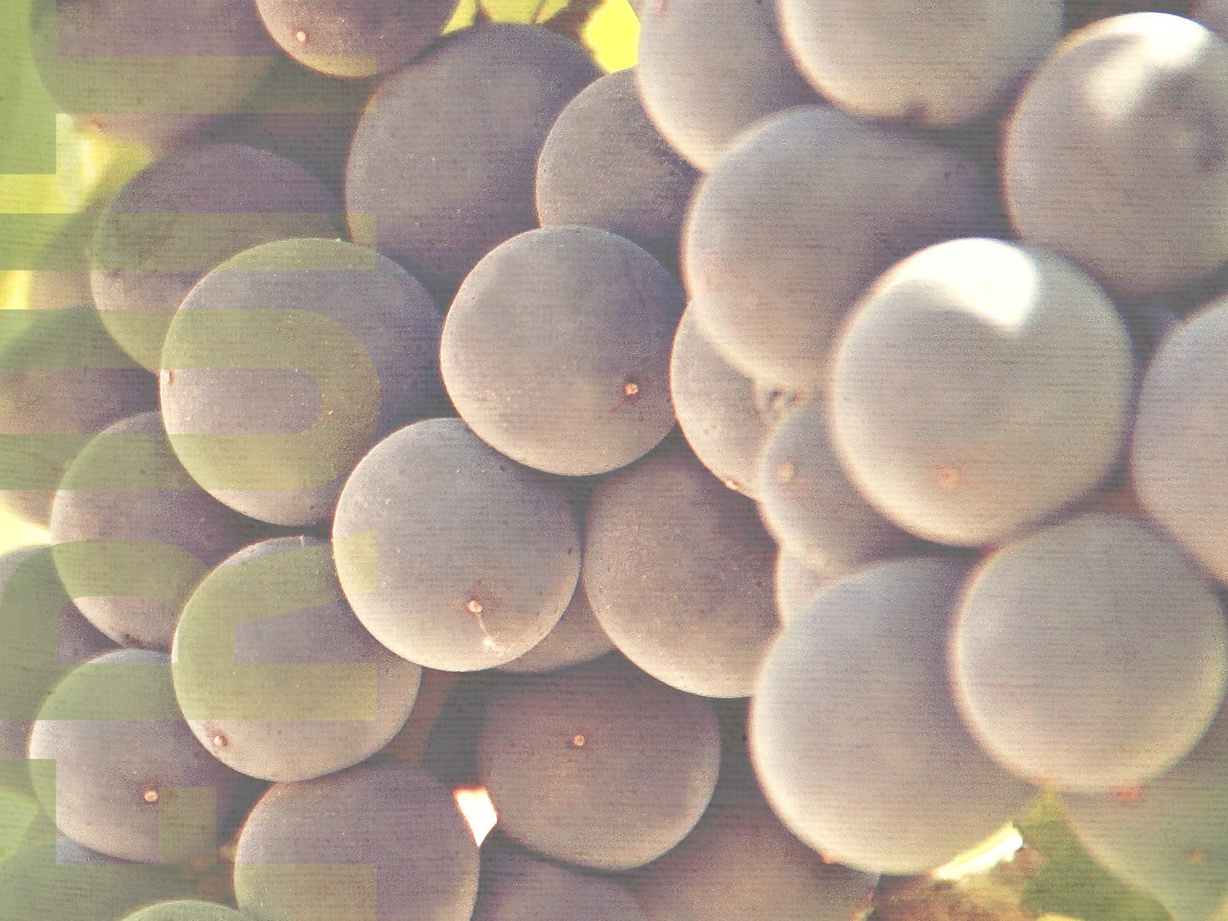
THE FRUIT OF MEEKNESS
Most people immediately equate meekness with weakness. Meekness actually requires great strength.

Slide 12
THE FRUIT OF MEEKNESS
The Meaning of Kindness
The dictionary defines it as “gentle, submissive, tame, or yielding.” Meekness is not weakness, but rather it is power under control. It includes three primary attitudes: (1) a submissiveness to the will of God (Col. 3:12); (2) teachableness (Jms. 1:21), and (3) a consideration of others (Eph. 4:2).

Slide 13
THE FRUIT OF MEEKNESS
The Motivation for Kindness
The Savior’s example (Mt. 11:28-29)
The Scripture’s exhortation (Col. 3:12)

Slide 14
THE FRUIT OF MEEKNESS
The Method of Meekness (James 1:21-22)
Meekness is having a repentant heart (Jms. 1:21).
Meekness is having a receptive heart (Jms. 1:21).
Meekness is having a responsive heart (Jms. 1:22).
Someone has said, “Impression without expression leads to depression”!

Slide 15
THE FRUIT OF TEMPERANCE
The word “temperance” means “self-control.” This is a governing of one’s desires. Temperance is the ability to pursue the important over the urgent, rather than to be always impulsive or uncontrolled.

Slide 16
THE FRUIT OF TEMPERANCE
The Problem of Temperance
We live in a society today that is out of control financially, physically, emotionally, and morally.

Slide 17
THE FRUIT OF TEMPERANCE
The Priority of Temperance
Temperance is total abstinence from all things forbidden and moderation in things permissible.
Physically: our body (I Cor. 6:19-20)
Mentally: our thoughts (Phil. 4:8)
Emotionally: our attitude (Prov. 25:28)

Slide 18
THE FRUIT OF TEMPERANCE
The Plan for Temperance
The way to self-control is to surrender to the Spirit’s control!

Slide 19
LESSON 4
The Fruit of
Faith, Meekness,
and Temperance

