Slide 1
LESSON 3
The Fruit of
Longsuffering, Gentleness,
and Goodness

Slide 2
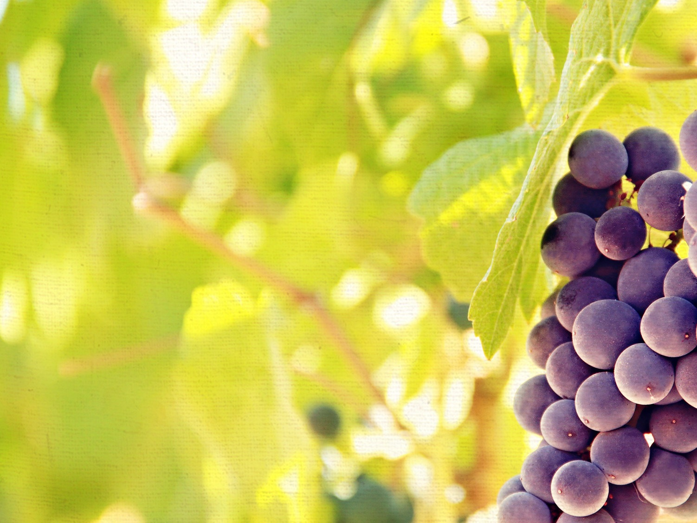
INTRODUCTION
There are the activities of filling our minds with Scripture and walking in obedience to God’s truth, but there is also allowing the Spirit of God to guide and direct us by His Word.
The fruit of the Spirit is the outward expression of Christ’s inward dwelling.

Slide 3
INTRODUCTION
Four descriptors about how the Spirit works in producing spiritual fruit:
Spiritual fruit is gradual in its growth.
Spiritual fruit is inevitable in its growth.
Spiritual fruit is internal in its growth.
Spiritual fruit is symmetrical in its growth.
Jonathan Edwards put it like this: ‘There is a concatenation of the graces of Christianity.’

Slide 4
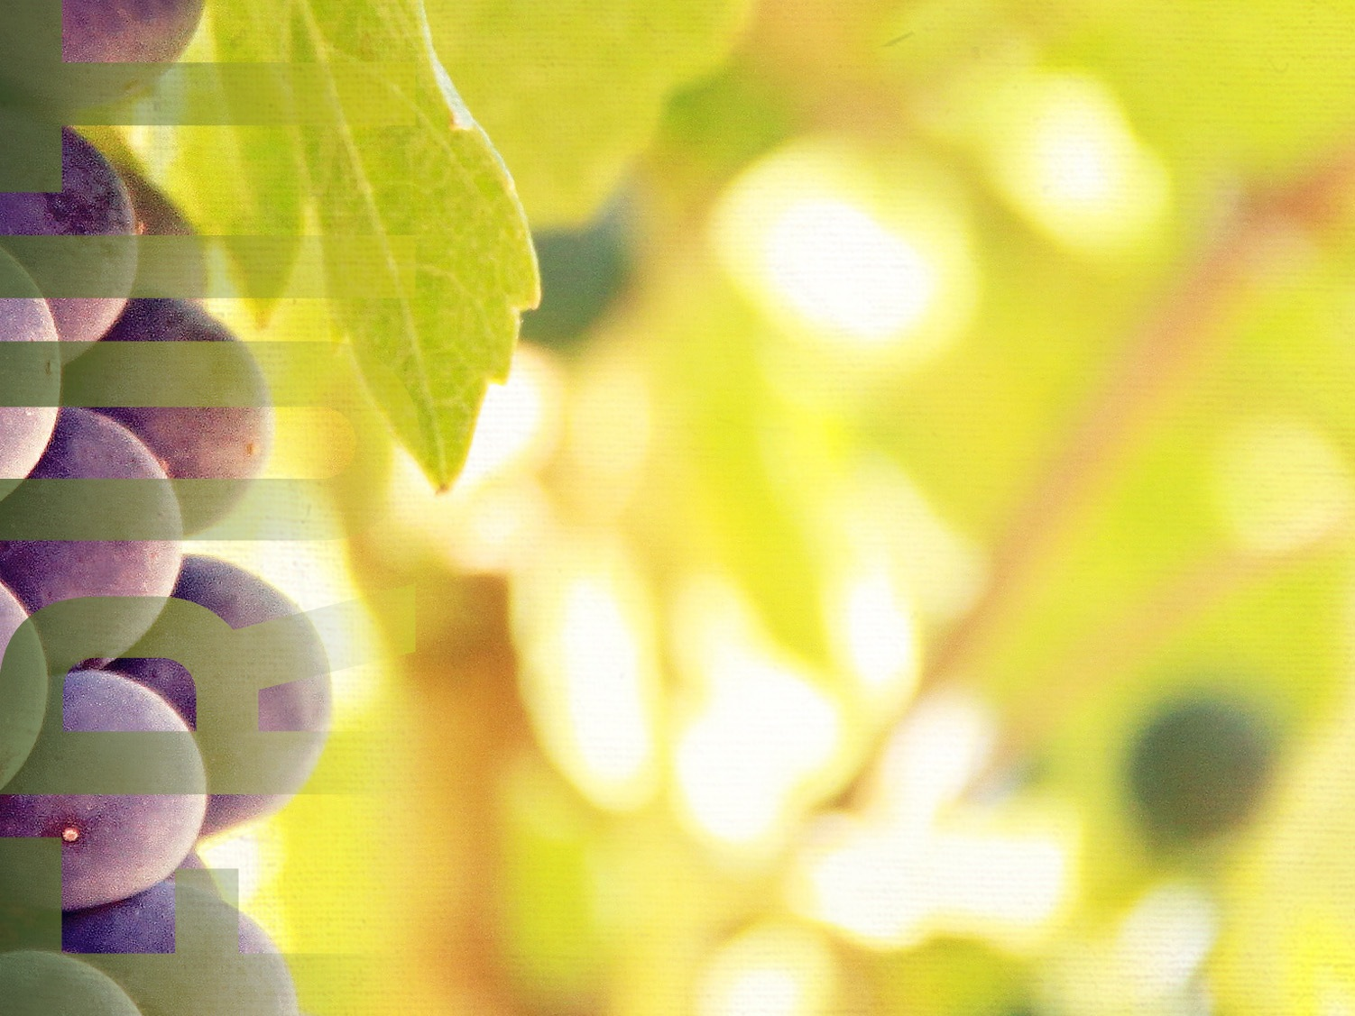
THE FRUIT OF LONGSUFFERING
The Definition of Longsuffering
It literally means to be long-tempered as opposed to being short-tempered.
Someone has said, “Patience is the ability to idle your motor when you feel like stripping your gears.”

Slide 5
THE FRUIT OF LONGSUFFERING
The Demonstration of Longsuffering
God tells us that we are to be longsuffering, but He never requires something of us that He himself does not perfectly demonstrate.
“We are to be imitators of Christ in refusing to be irritated by the wrongs people do to us.”

Slide 6
THE FRUIT OF LONGSUFFERING
The Development of Longsuffering
Often when we ask God for patience, He gives us opportunities to practice patience.

Slide 7
THE FRUIT OF LONGSUFFERING
The Development of Longsuffering
God uses problems to develop patience.
God’s goal for you is spiritual growth and maturity.
God uses people to develop patience.
It seems that often the people we love the most also try our patience the worst.

Slide 8
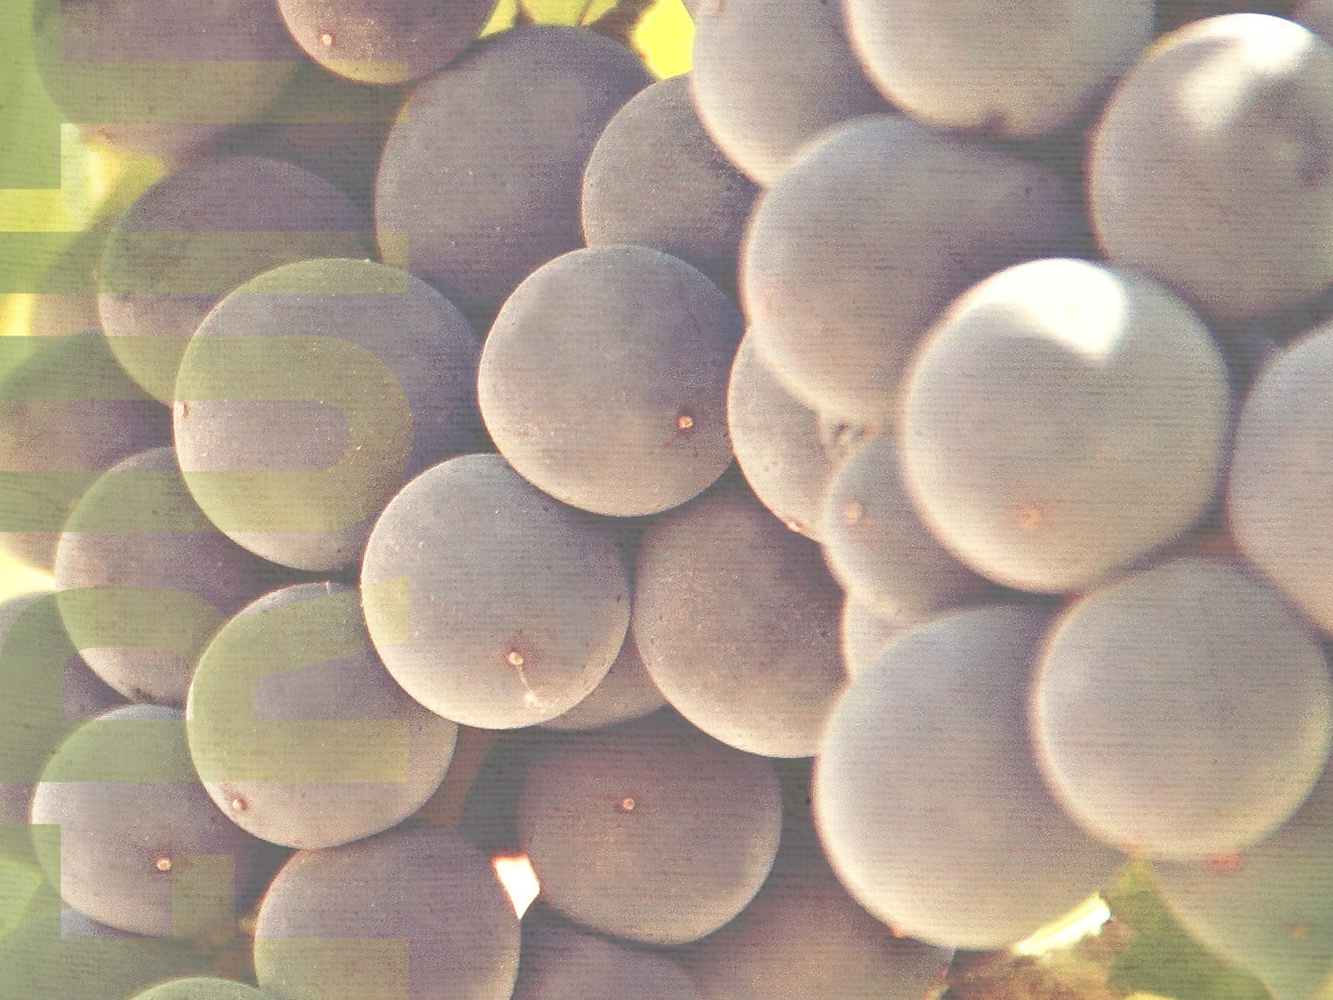
THE FRUIT OF GENTLENESS
Another word for gentleness is kindness.
The Explanation of Kindness
Gentleness is the inward work of the Holy Spirit that produces sweetened outward attitudes and actions.

Slide 9
THE FRUIT OF GENTLENESS
The Expectation of Kindness (Eph. 4:32a)
At the heart of biblical, practical Christianity is kindness and forgiveness.
It easy to be kind to those who are kind to us, but we are called to be kind even to our enemies.

Slide 10
THE FRUIT OF GENTLENESS
The Exemplification of Kindness (Eph. 4:32b)
What God expects of us, He exemplifies for us.
Kindness is simply treating others the way God has treated you.
One of the greatest marks of leadership is kindness. It is nice to be important, but it is more important to be nice!

Slide 11
THE FRUIT OF GOODNESS
Real goodness is not a material or physical, but a spiritual matter.
The Identification of Goodness
Goodness has to do with moral and spiritual excellence that is known by its active kindness.

Slide 12
THE FRUIT OF GOODNESS
The Illustration of Goodness
Only God is truly good (Ps. 34:8).
We must keep our eyes on the goodness of Christ as we deal with others.
In fact, if you take “G-o-d” out of “g-o-o-d” you end up with a big zero (“0”).

Slide 13
THE FRUIT OF GOODNESS
The Implementation of Goodness
In Acts 11, we are told that Barnabas was “a good man and full of the Holy Ghost.”
Goodness is not primarily a matter of what you know, or what you do, but what you are.

Slide 14
THE FRUIT OF GOODNESS
“We need the kind of life that has such integrity in relation to Christ that those around us who are comfortable in their apathy, unconcern, and insensitivity will be afflicted by our very presence, and those who are afflicted by the pains and problems of life will be comforted by our same presence.”

Slide 15
CONCLUSION
The way to spiritual fruit bearing is not through trying (self-effort) it is through trusting (Spirit’s power).

Slide 16
LESSON 3
The Fruit of
Longsuffering, Gentleness,
and Goodness

