Slide 4
LESSON 5: The Goodness and Love of God

Slide 5
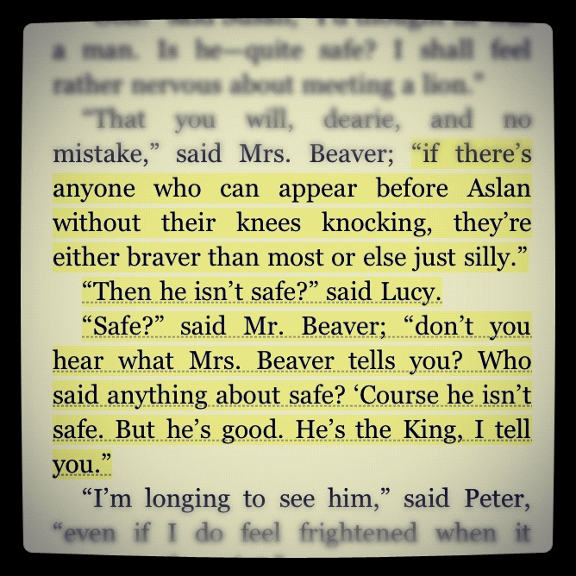
INTRODUCTION

Slide 6
God is good (Psalm 106:1-5).
God is the standard of good.
Good – “everything God is and does is worthy of approval”
God is the source of good.
“The highest good, than which there is no higher, is God, and consequently He is unchangeable good, hence truly eternal and truly immortal. All other good things are only from Him.” –Augustine (354-430)

Slide 7
God is good (Psalm 106:1-5).
Application: God’s good character leads Him to purpose good toward others and to act in accordance with His goodness. We are to respond with praise. If praise and worship mark our vertical response to God’s goodness, then our horizontal response is to do good to others (Galatians 6:9-10). Because we humans are naturally selfish and not good, it’s only as we have been transformed by God’s goodness that we truly extend goodness to others.

Slide 8
God is merciful (Psalm 106:6-12).
Merciful – “God’s goodness toward those in misery or distress”
God’s mercy is freely given.
God is not obligated to express mercy, but He delights in showing mercy. God’s goodness always prevails, even when He chooses not to extend mercy in a particular situation.
God’s mercy is faithfully given.
God acts faithfully towards us even when we have rebelled against Him. His mercy spares us from what we rightfully deserve through redemption of sinners who trust in Him.

Slide 9
God is merciful (Psalm 106:6-12).
Application: Since we have received and been changed by the mercy of God experienced in salvation, we must seek to express mercy to others. In the Sermon on the Mount, Jesus proclaimed, “Blessed are the merciful: for they shall obtain mercy” (Matthew 5:7). This suggests an ever-increasing cycle. When we as sinful individuals receive God’s mercy, we show mercy to others. And then others reflect mercy back to us. And then we extend more mercy. And so on.

Slide 10
God is love (1 John 4:7-11).
Love – “God’s eternally giving Himself to others”
The source of God’s love (1 John 4:7-8)
The cost of God’s love (1 John 4:9-10)
The result of God’s love (1 John 4:9)
The overflow of God’s love (1 John 4:11)

Slide 11
God is love (1 John 4:7-11).
Application: When we focus on God’s self-giving love, we see that it is the basis for our salvation. It is the motivation for our loving God. It is the motivation for our loving others. We show the world that God is love, that He is good and merciful, by our own love-prompted actions and words.

Slide 12
CONCLUSION
God’s goodness is that all He is and does that is worthy of approval. God’s mercy is His goodness to those in misery and distress. God’s love is His giving of Himself to others, in particular His giving of Himself in the Person of Jesus as the propitiation for our sins so that we may have life.
How am I to reflect God’s goodness, mercy, and love? Because I have experienced the sheer goodness of God—beyond counting blessings—I have the wonderful opportunity and responsibility to do good to all (Galatians 6:10). Because I have received God’s mercy, God intends for me to extend to others the mercy I have been shown. And because I have experienced that God loves me, a sinner, then “if God loved us in this way, we also must love one another” (1 John 4:11).

Slide 13
NEXT WEEK: God’s Holy and Righteous Character (Psalm 99; Exodus 34:14)

